Slide 1
Dynamic Programming
Practice session
Omkar Deshpande

Slide 2
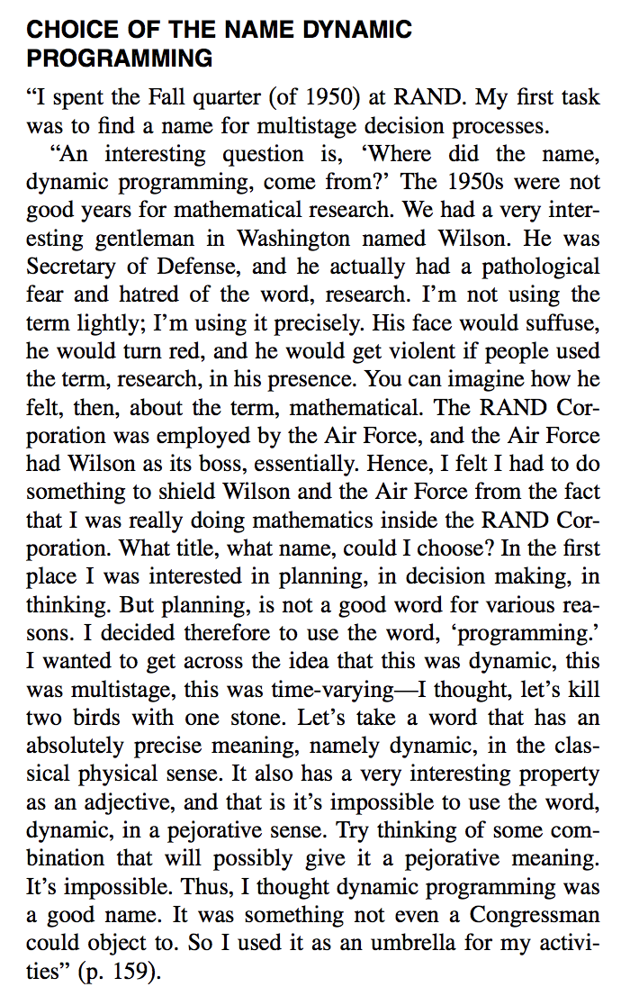

Richard Bellman

Slide 3
“Mathematics:
Some interviewers ask basic discrete math questions. This is more prevalent at Google than at other companies because we are surrounded by counting problems, probability problems, and other Discrete Math 101 situations. Spend some time before the interview refreshing your memory on (or teaching yourself) the essentials of combinatorics and probability. You should be familiar with n-choose-k problems and their ilk - the more the better.”
https://careers.google.com/how-we-hire/interview/#interviews-for-software-engineering-and-technical-roles

Slide 4
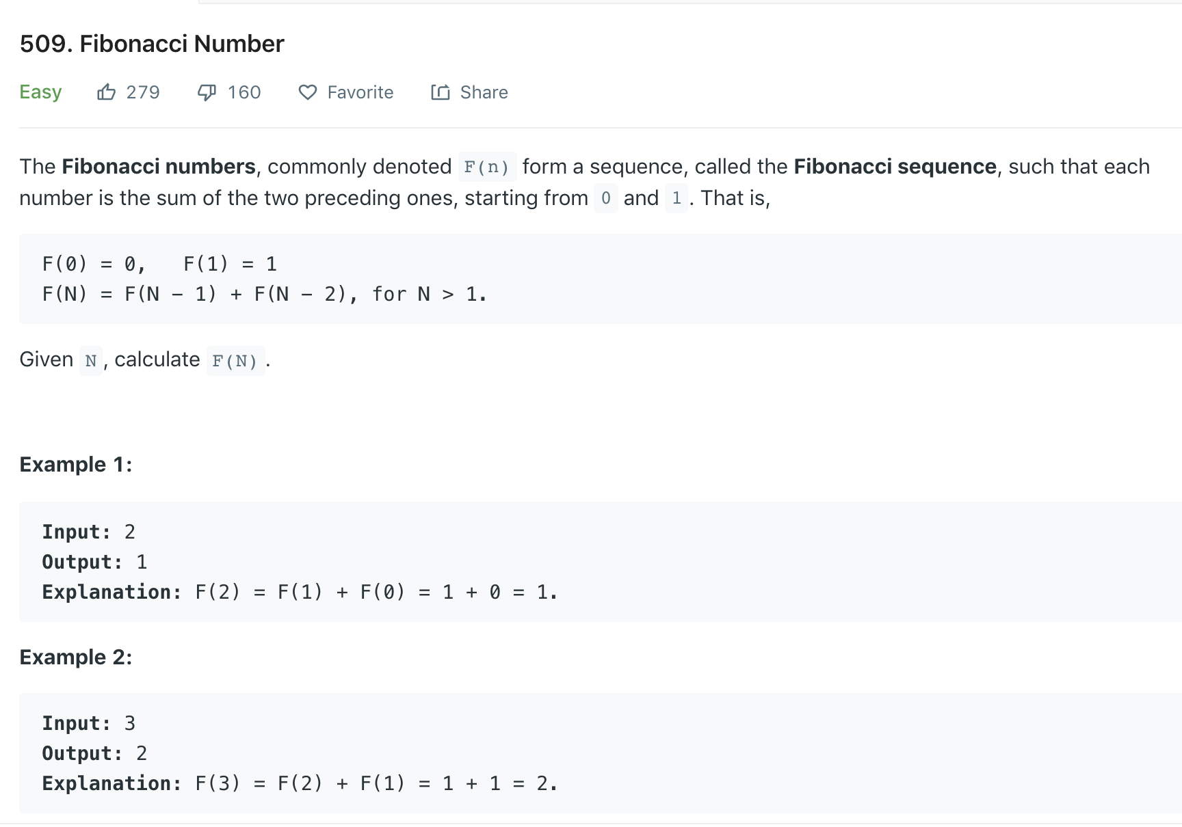

Slide 5
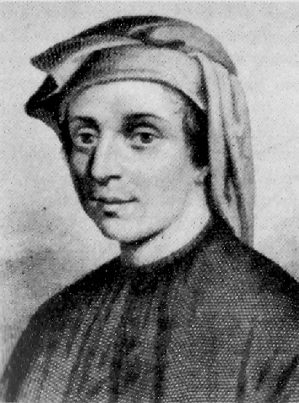
Leonardo of Pisa (1170-1250)

Slide 6
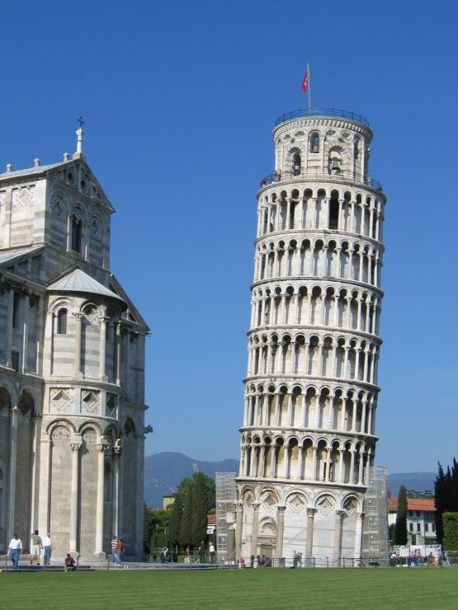
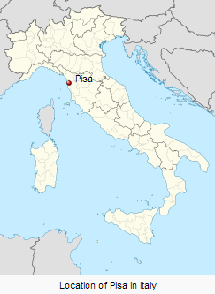
Pisa
The leaning tower of Pisa

Slide 7
Leonardo of Pisa (1170-1250)
filius Bonaccio, “son of Bonaccio”: Fibonacci

Slide 8
Liber abaci (Book of Counting)
Chapter 1:
“These are the nine figures of the Indians:
9 8 7 6 5 4 3 2 1.
With these nine figures, and with this sign 0… any number may be written, as will be demonstrated below.”

Slide 9
Liber abaci, chapter 12
A man put one pair of (newborn) rabbits in a certain place entirely surrounded by a wall. How many pairs of rabbits can be produced from that pair in a year, if the nature of these rabbits is such that every month, each pair bears a new pair which from the second month on becomes productive?
(Assume no rabbits die)

Slide 10
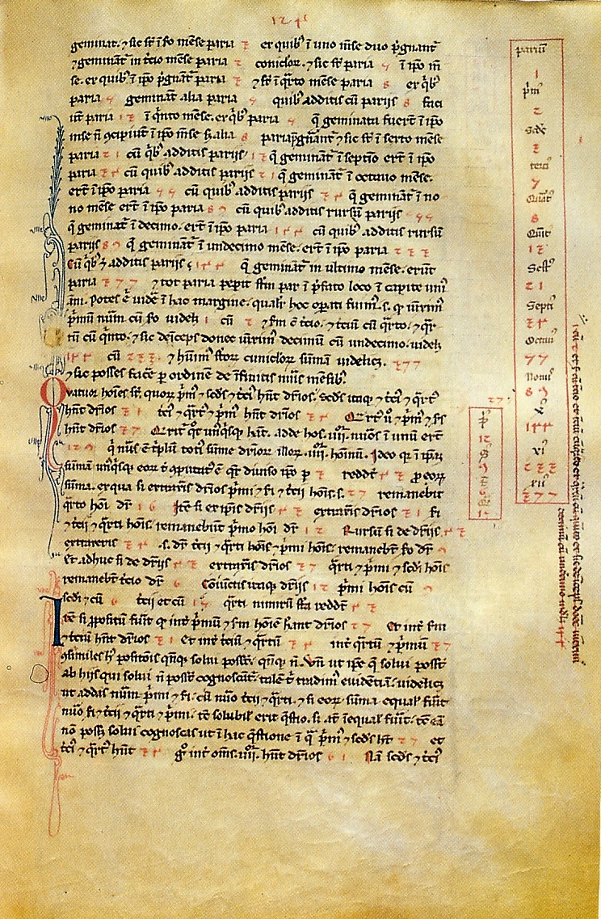
"It is ironic that Leonardo, who made valuable contributions to mathematics, is remembered today mainly because a 19th-century French number theorist, Édouard Lucas... attached the name Fibonacci to a number sequence that appears in a trivial problem in Liber abaci"
(Martin Gardner, Mathematical Circus)

Slide 11
New month’s adults = All the rabbit pairs from previous month
New month’s young = Previous month’s adults = Previous to previous month’s rabbit pairs

Slide 12
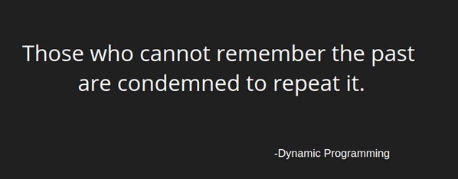
Exponential solution

Slide 13
Working definition: DP = Recursion without repetition
Memoized solution

Slide 14
DP solution that runs in linear time, linear space

Slide 15
DP solution that runs in linear time, O(1) space

Slide 16
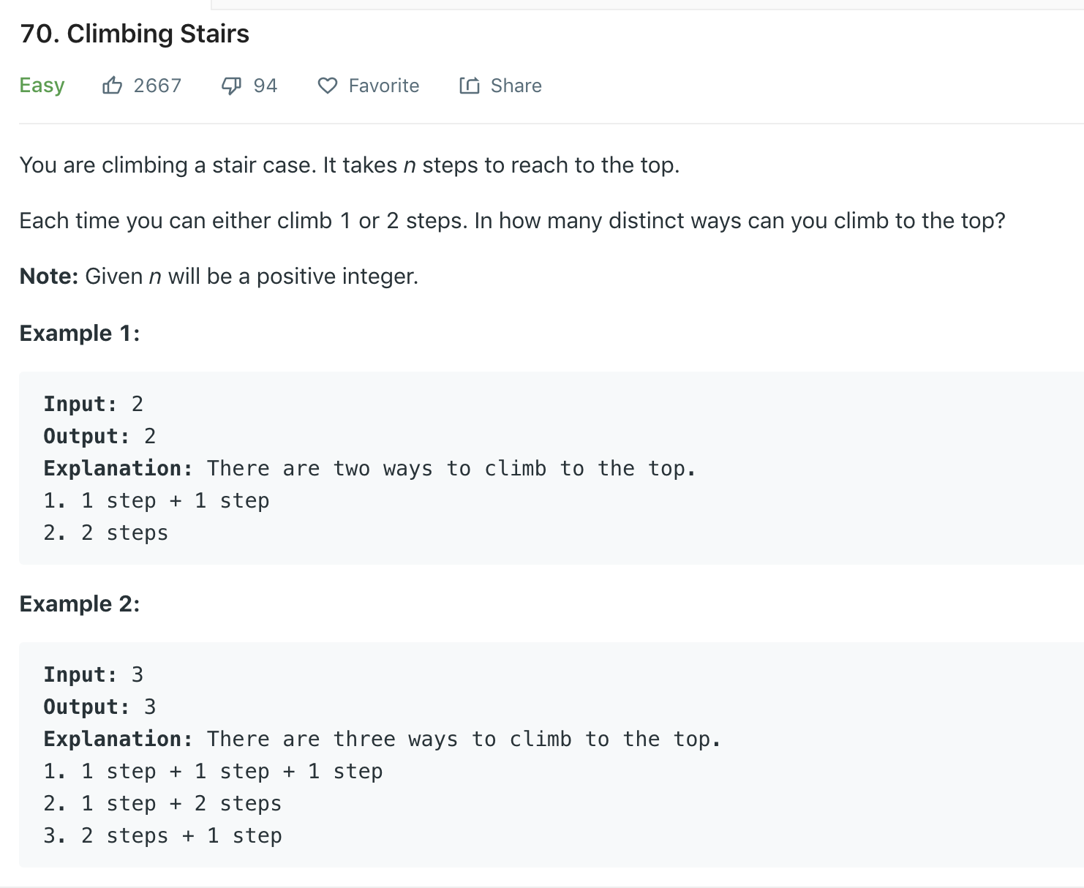

Slide 17
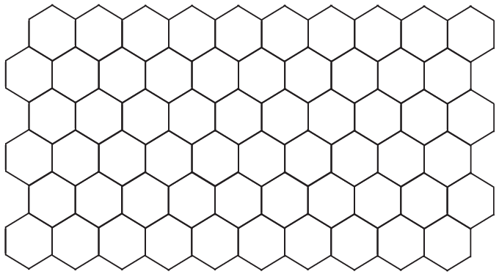

Slide 18
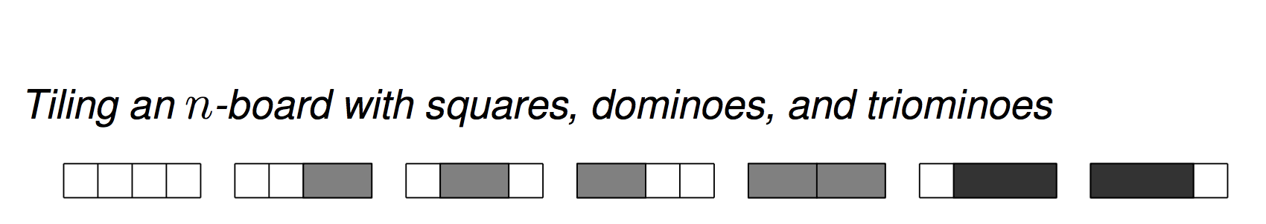

Slide 19
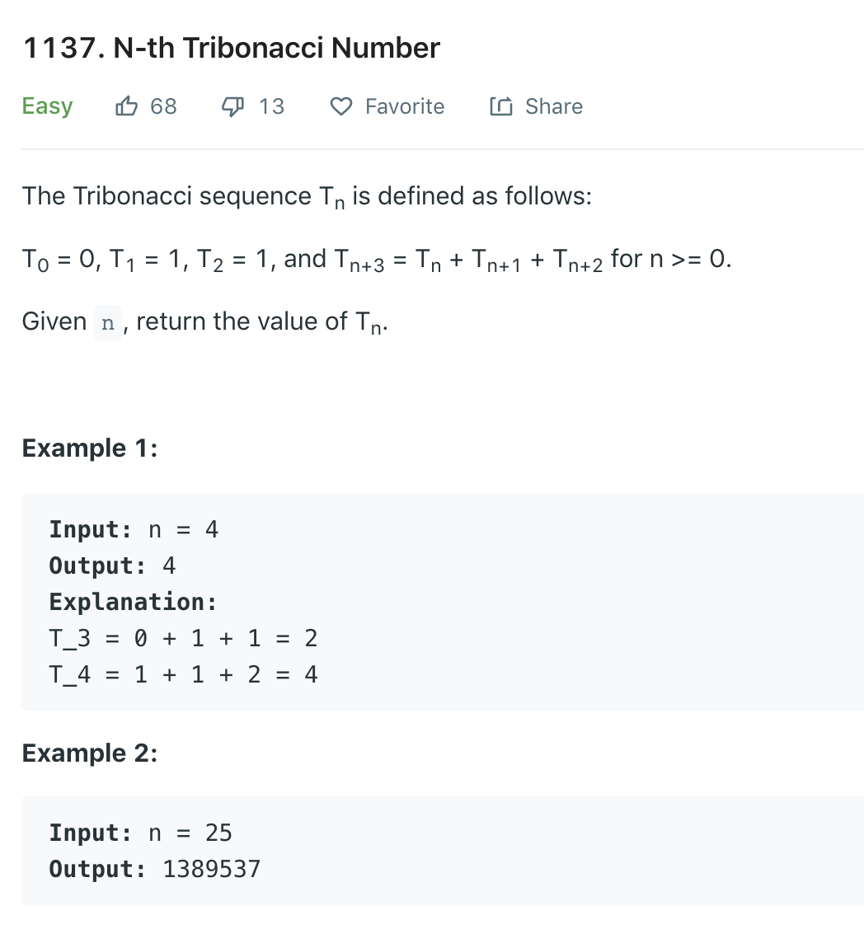

Slide 20
DP solution in O(n) time, O(1) space

Slide 21
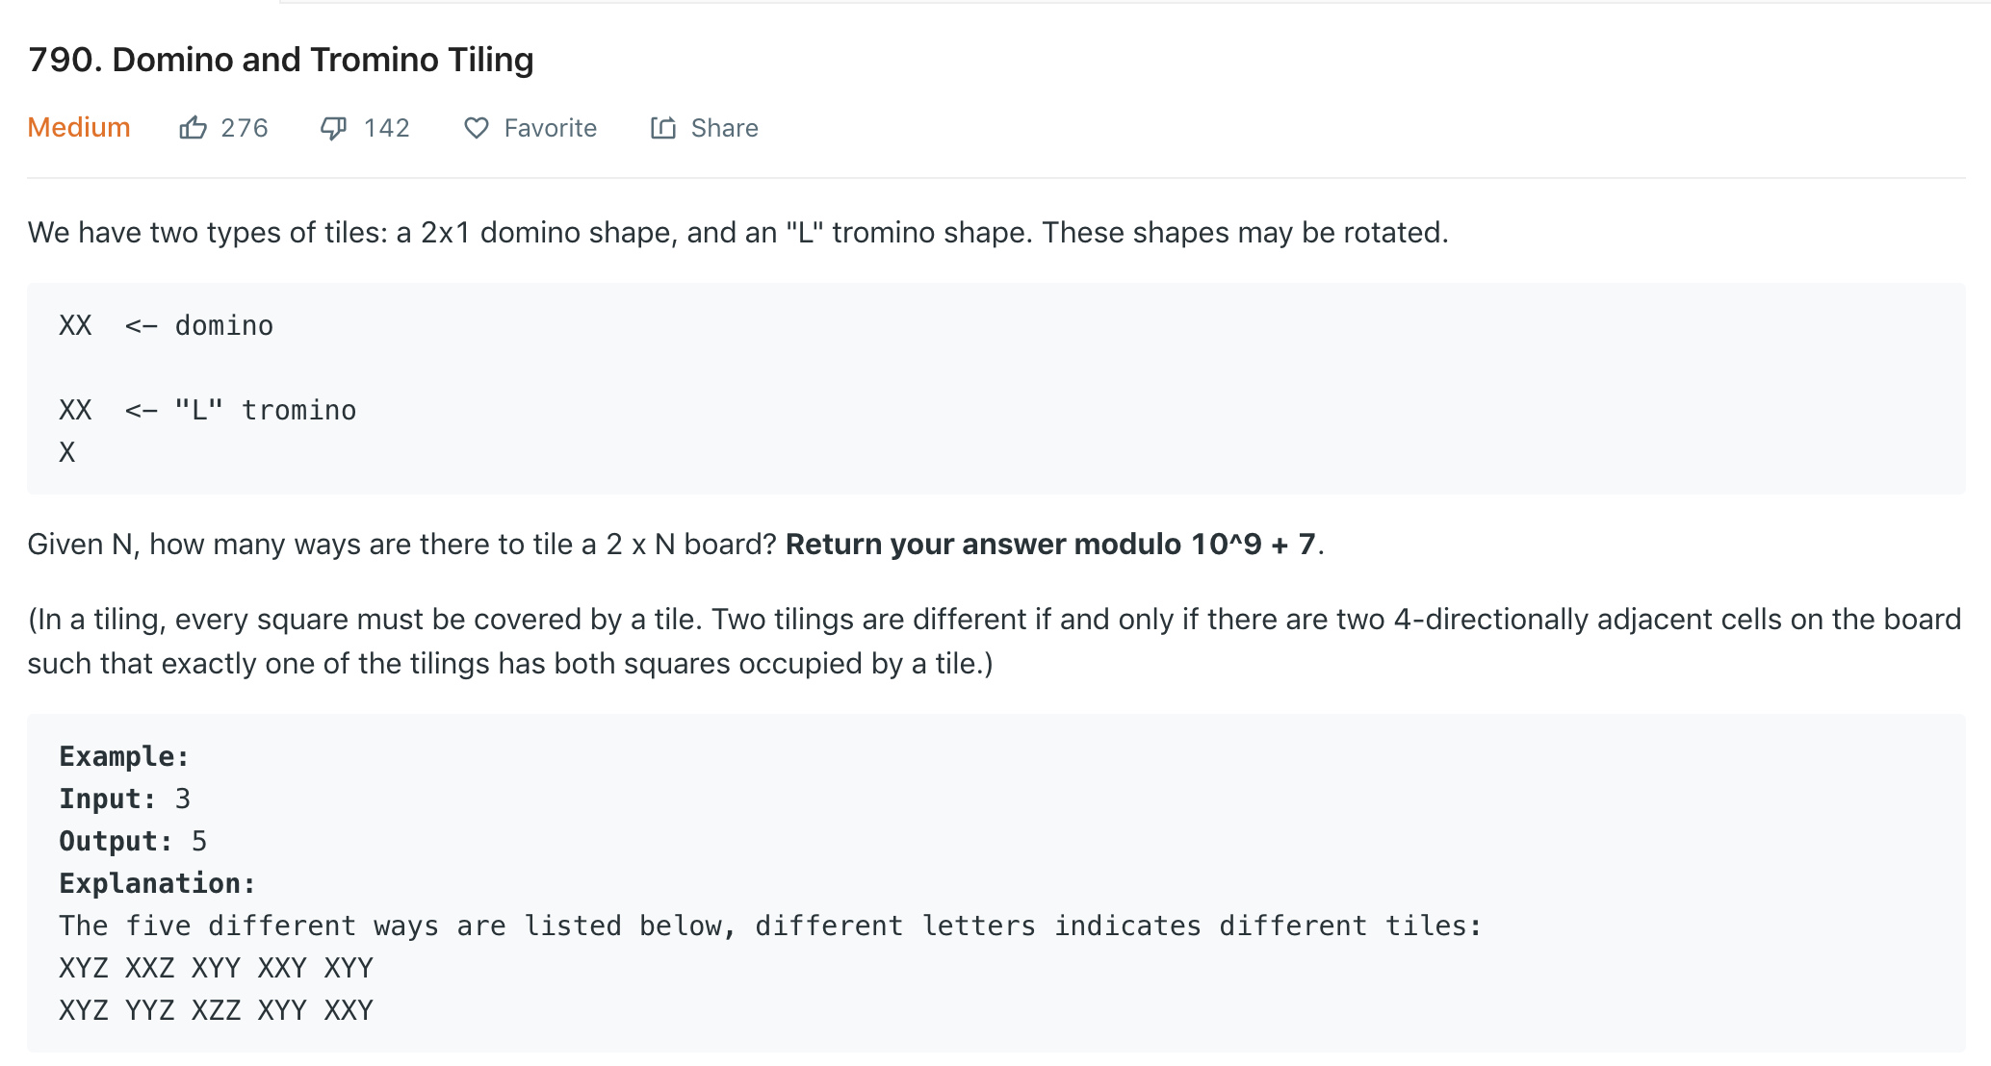
Notes:
f(n) = f(n-1) + f(n-2) + u(n-2) + l(n-2)
0 to n
u[0]=0,u[1] = 1

Slide 22
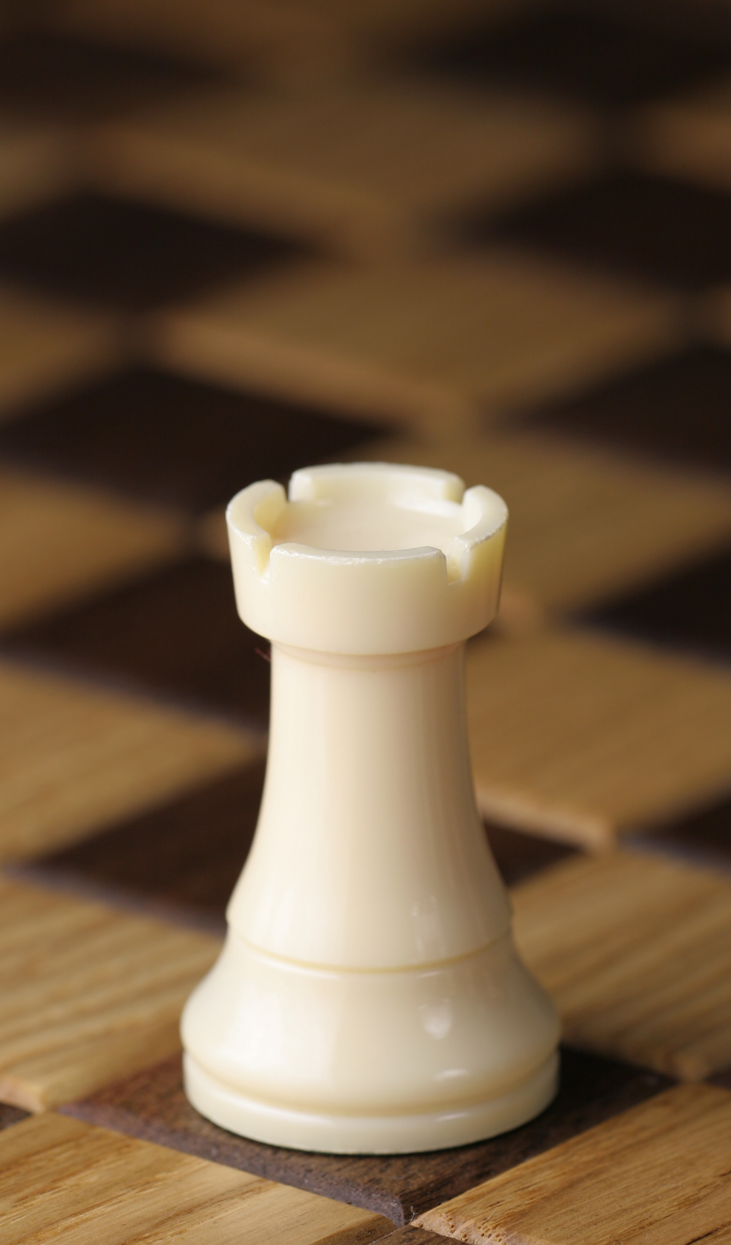
Shortest path counting
A chess rook can move horizontally or vertically to any square in the same row or in the same column of a chessboard. Find the number of shortest paths by which a rook can move from one corner of a chessboard to the diagonally opposite corner
Use a dynamic programming algorithm
Use elementary combinatorics

Slide 23
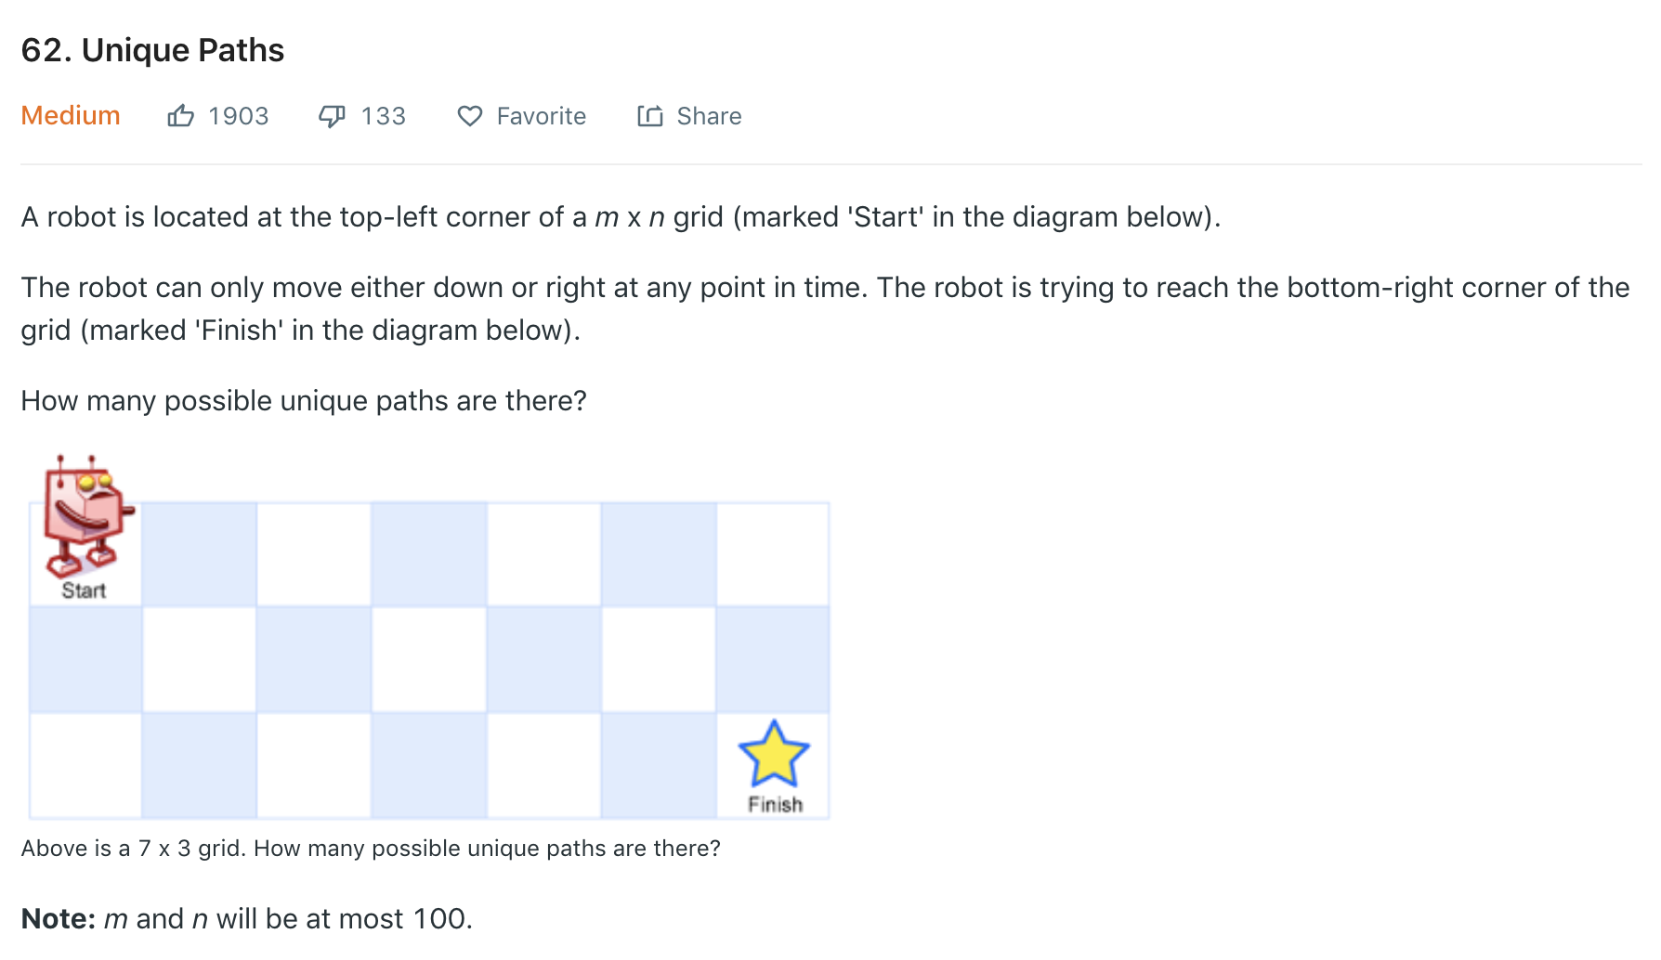

Slide 24
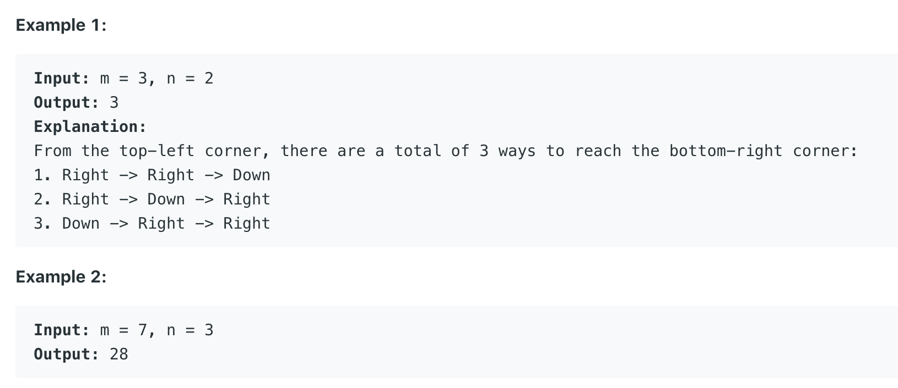

Slide 25
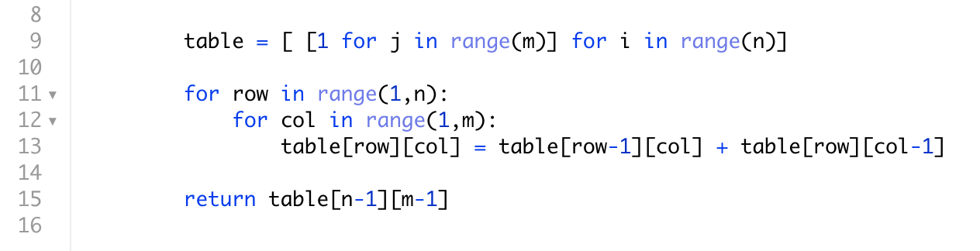

Slide 26
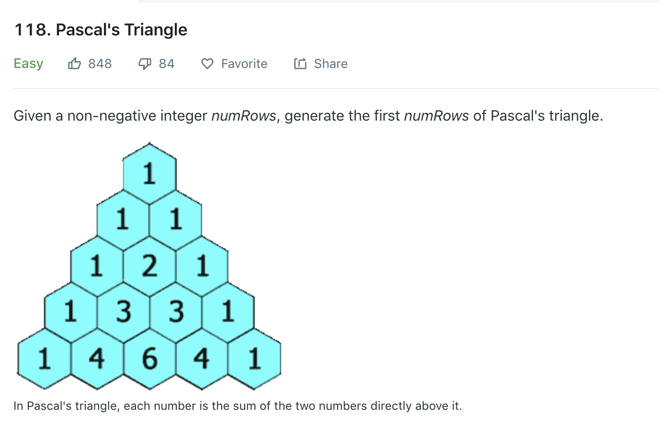

Slide 27
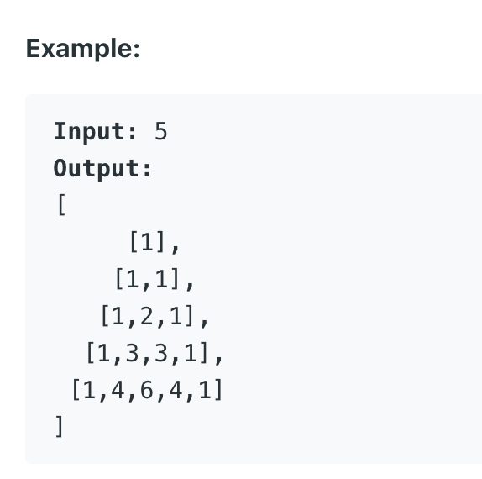

Slide 28
Properties of Pascal’s triangle
C(n,k) = C(n-1,k) + C(n-1,k-1)
Symmetry: C(n,k) = C(n,n-k)
Row sum = 2^{n}
Hockey stick identity

Slide 29
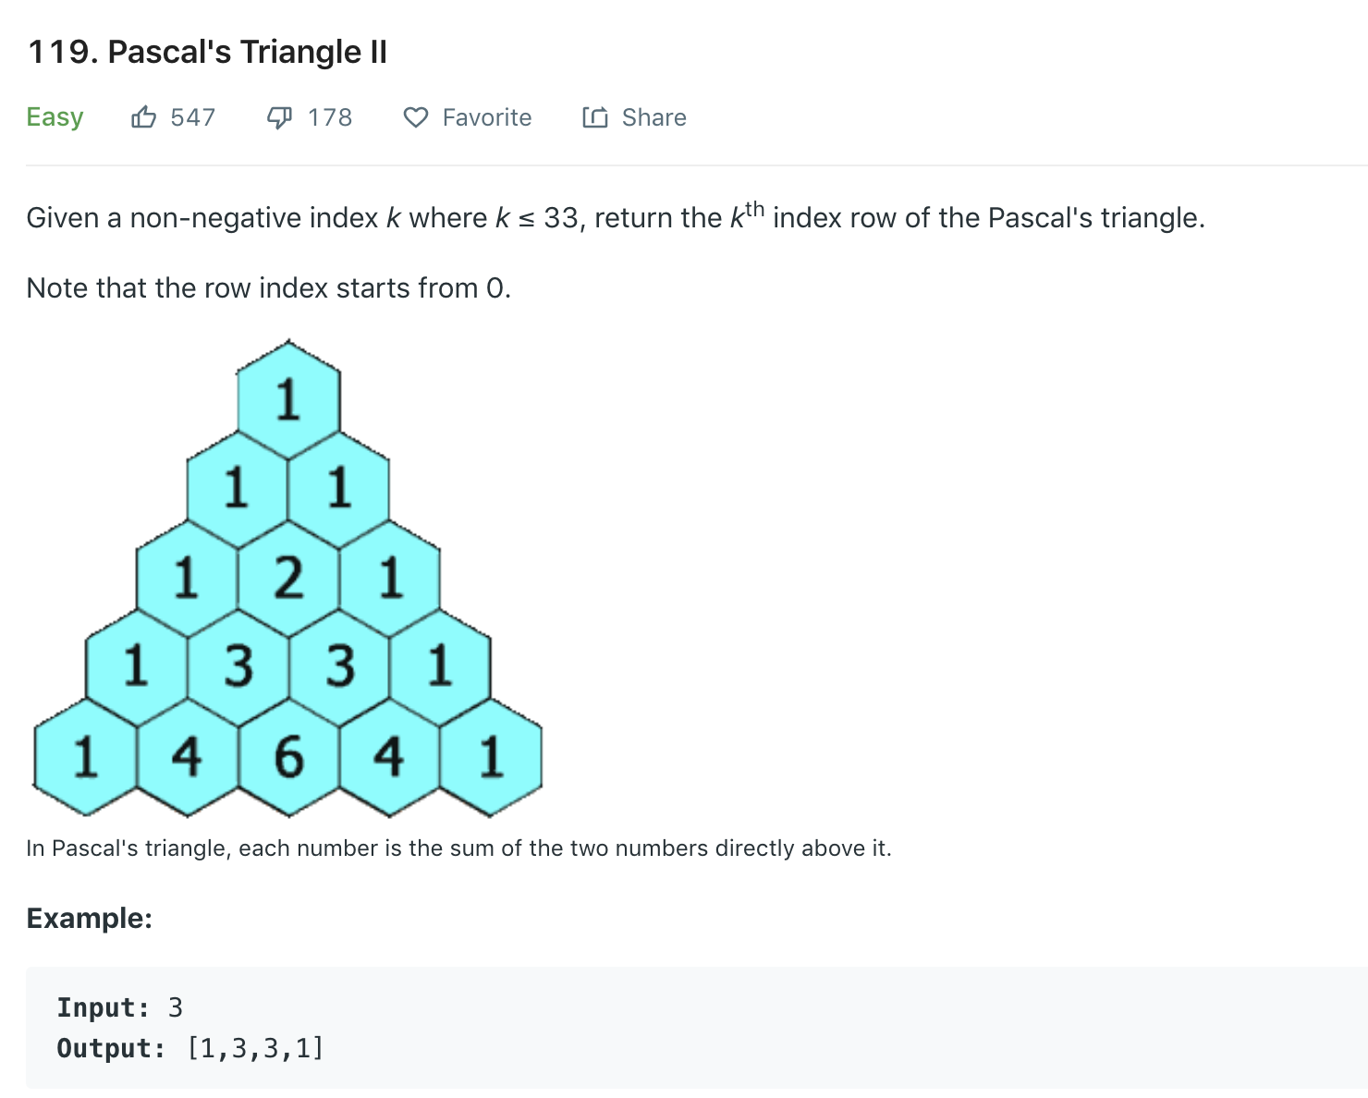

Slide 30
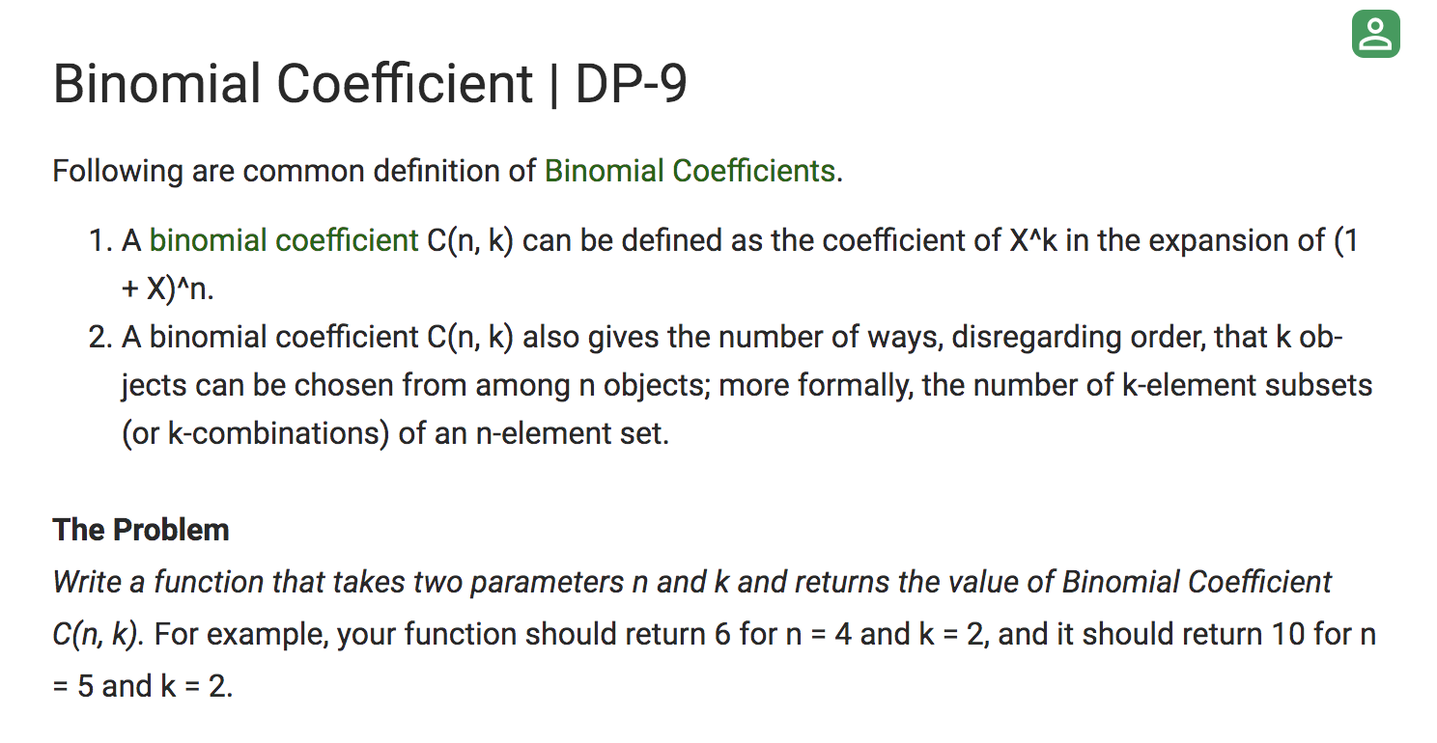

Slide 31
Dynamic Programming
Practice session 2
Omkar Deshpande

Slide 32
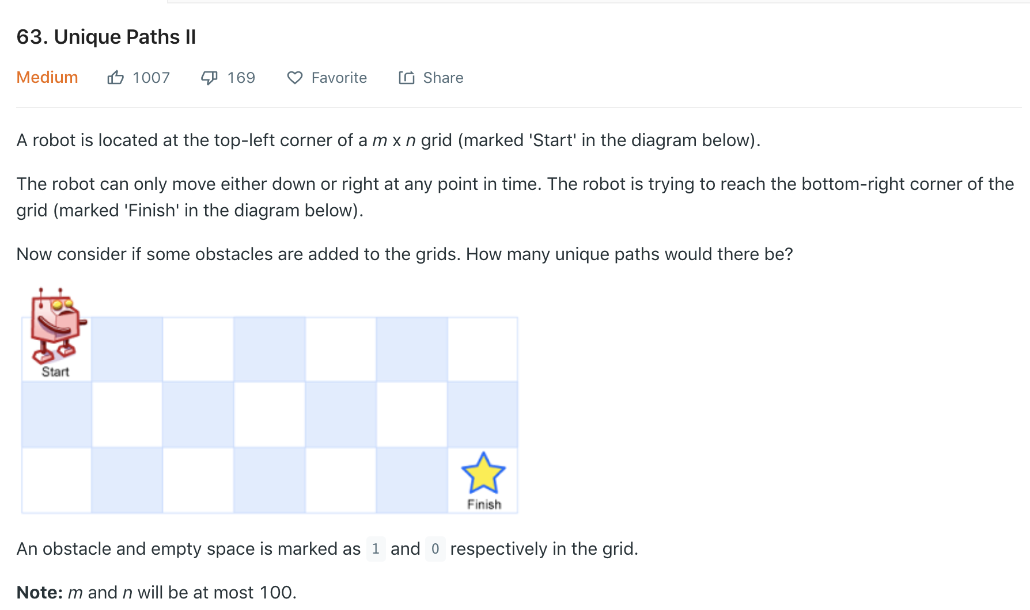
Notes:
There is no reason to add an extra row or column here, because this is the “number of paths” problem in a DAG and the DAG needn’t have been regular.

Slide 33
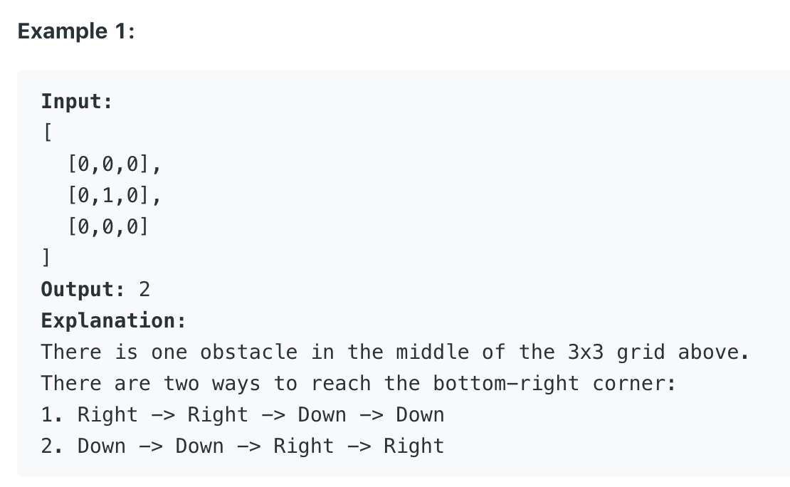

Slide 34
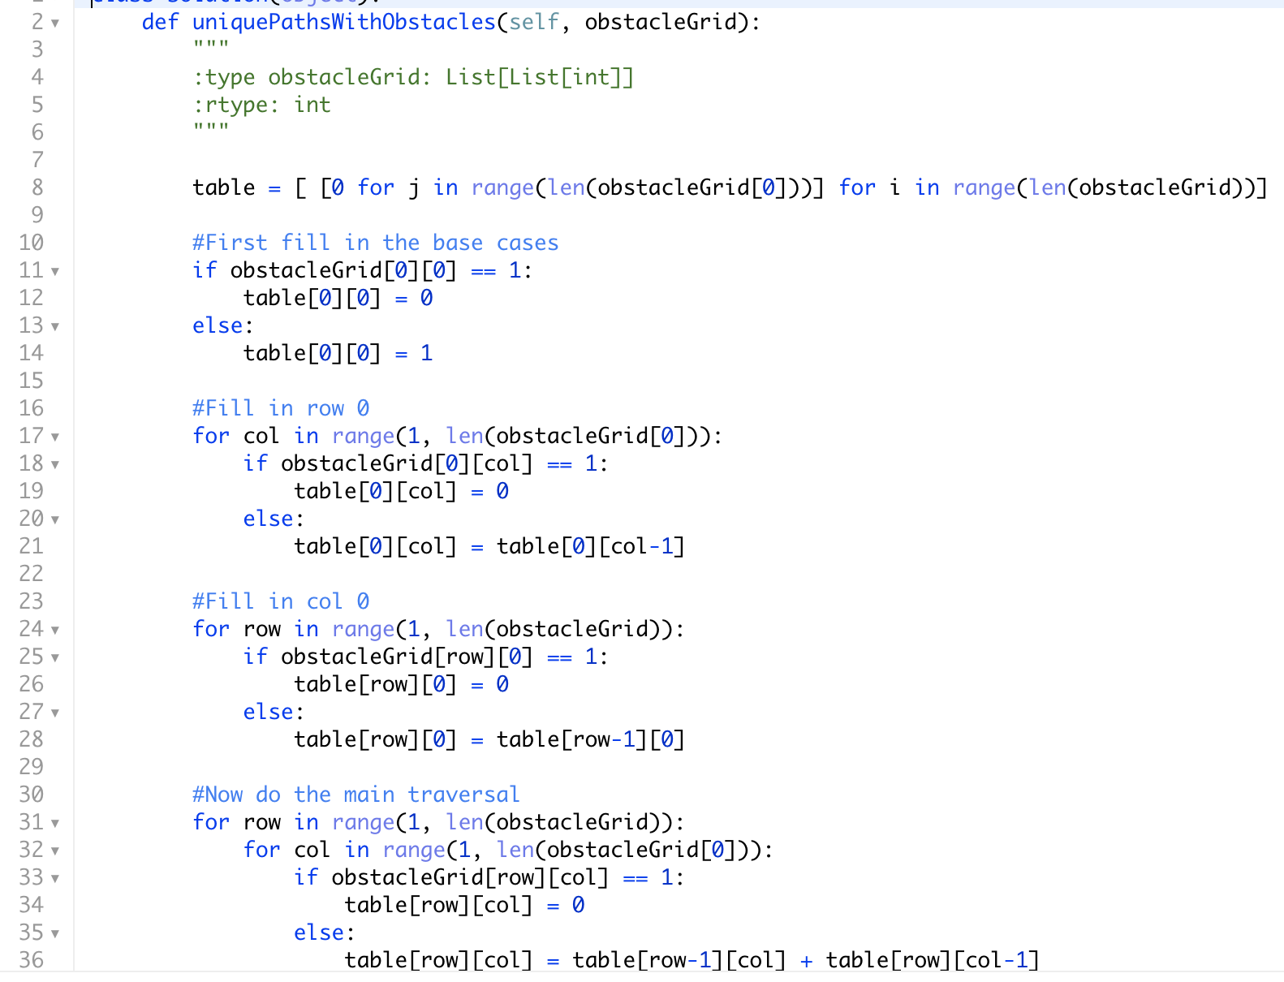

Slide 35
What if the grid was not regular but in the shape of a general graph?

Slide 36
From Counting problems to Optimization
“Principle of optimality”

Slide 37
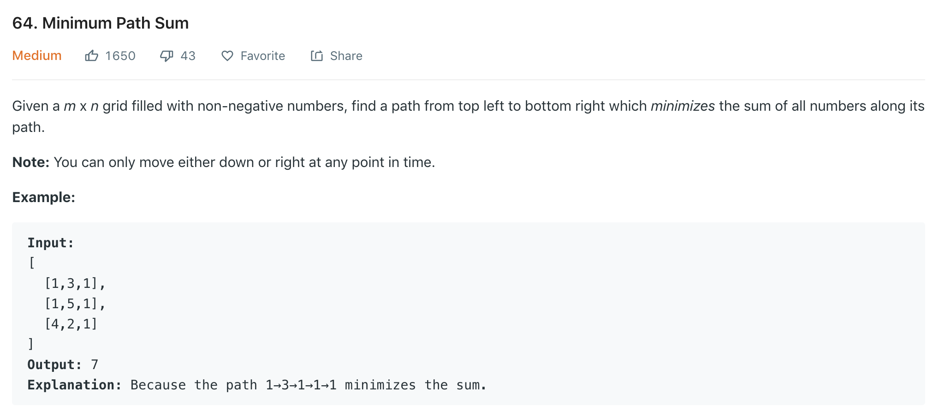

Slide 38
Optimization problem Optimal substructure + Overlapping subproblems

Slide 39
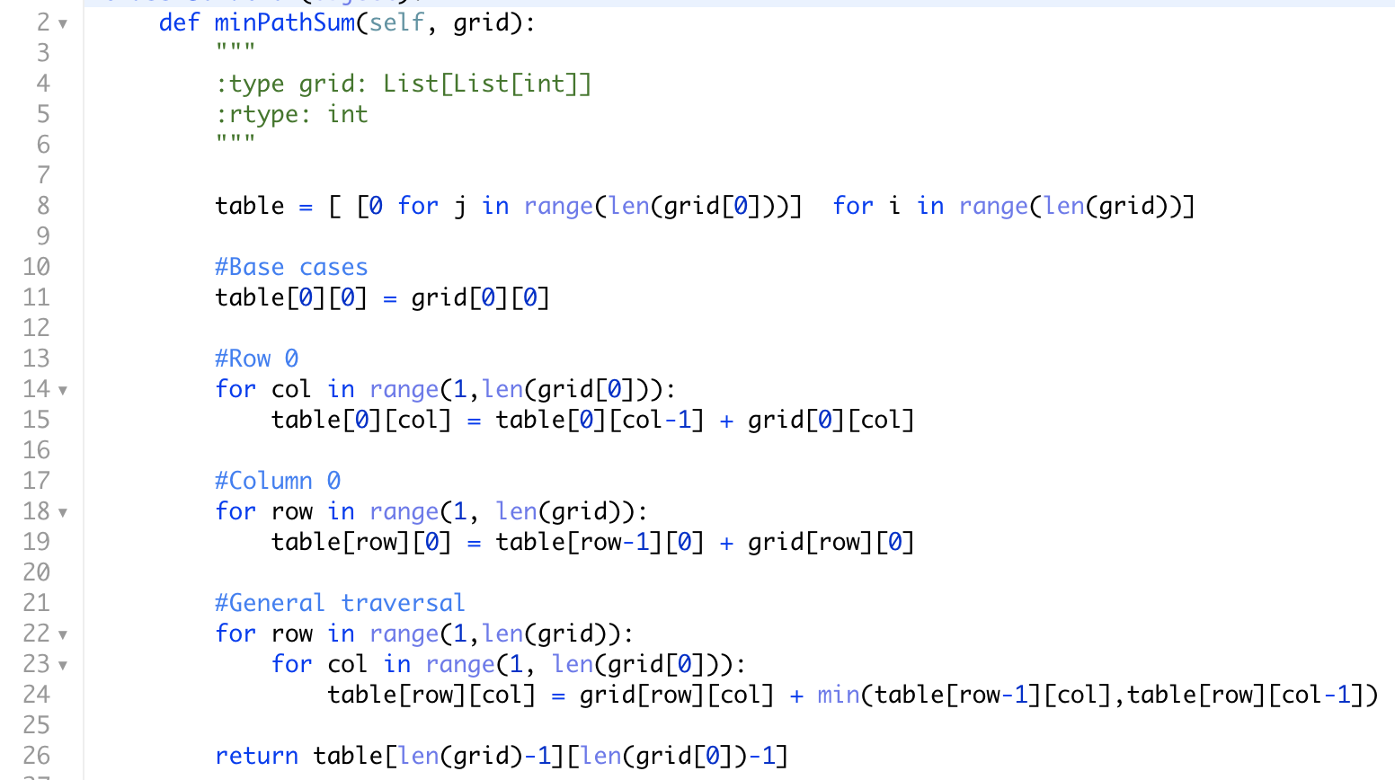

Slide 40
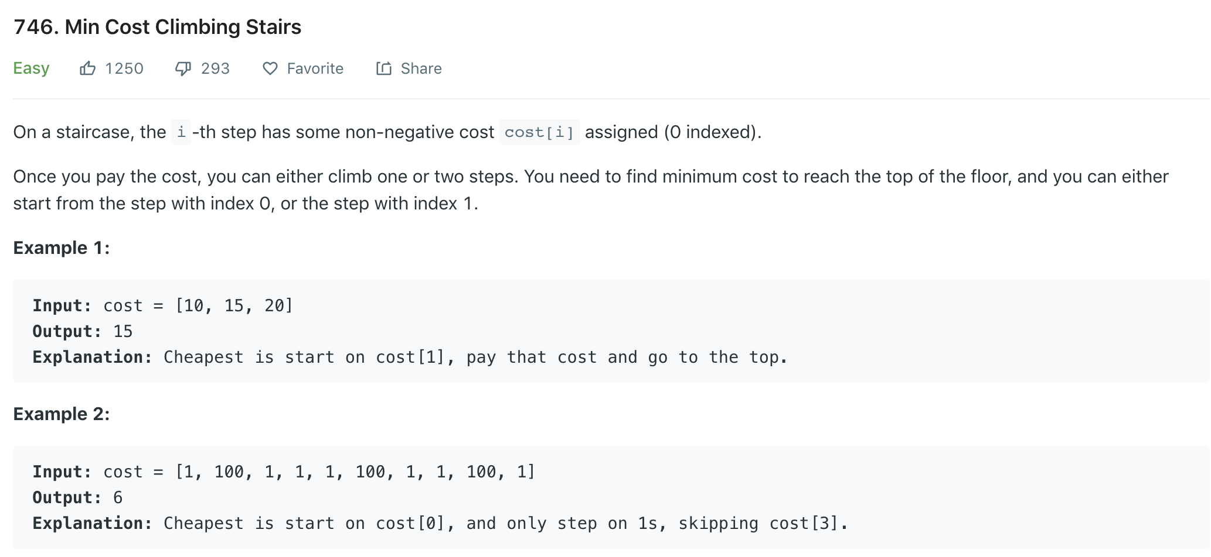

Slide 41
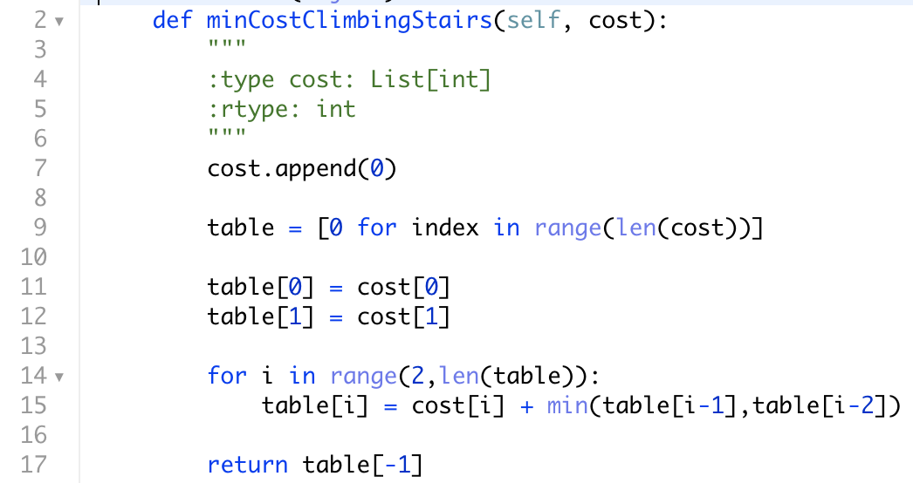

Slide 42
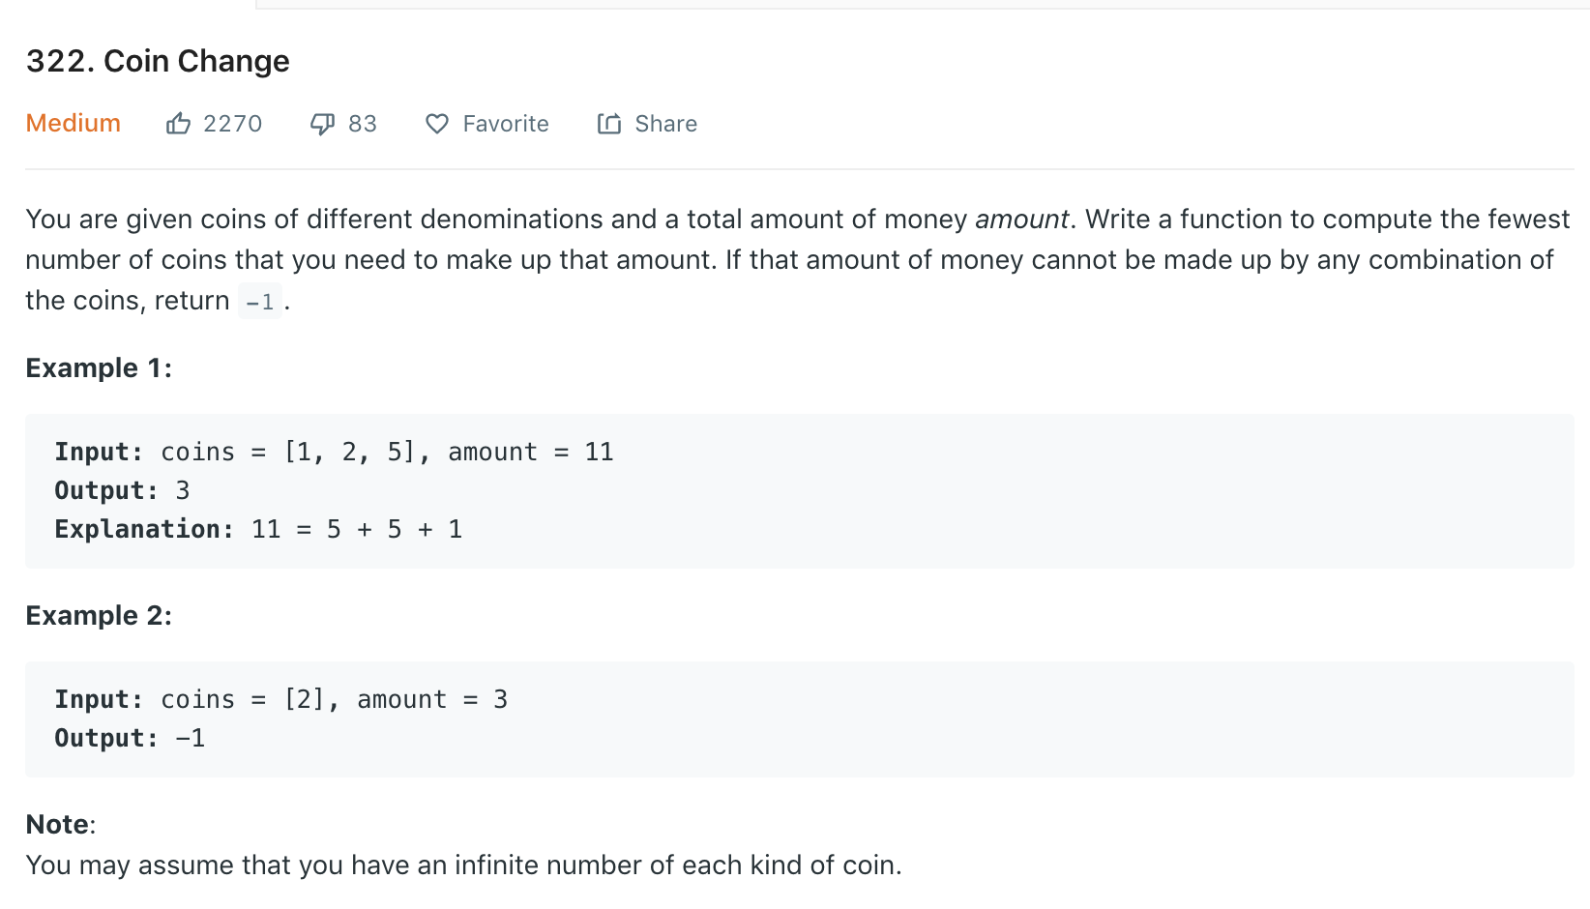

Slide 43
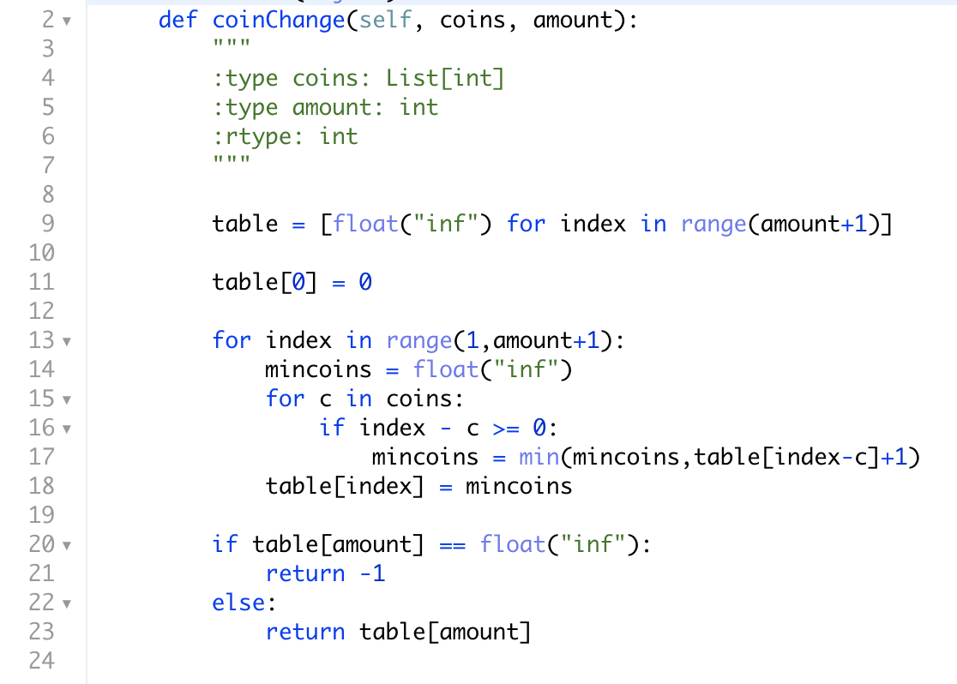

Slide 44
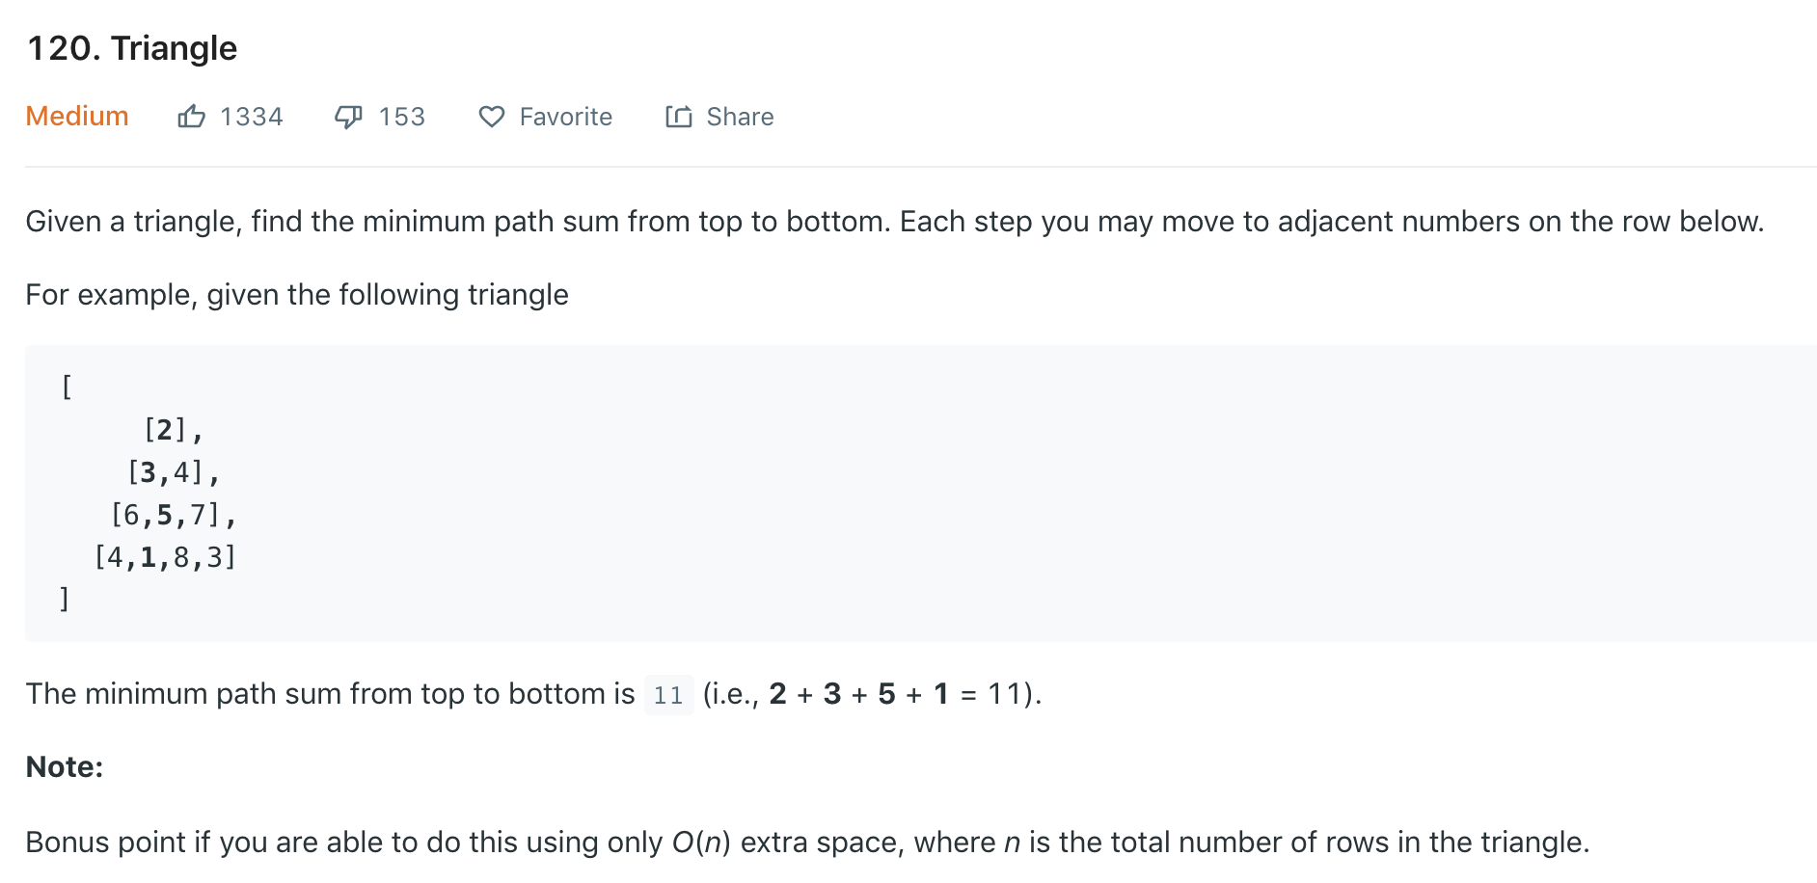

Slide 45
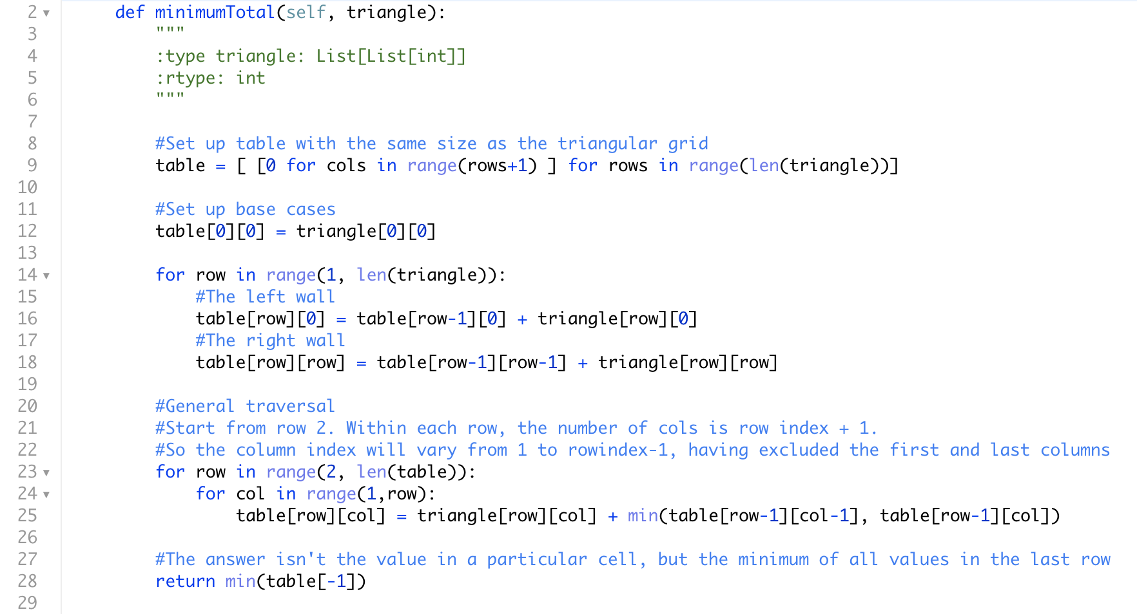

Slide 46
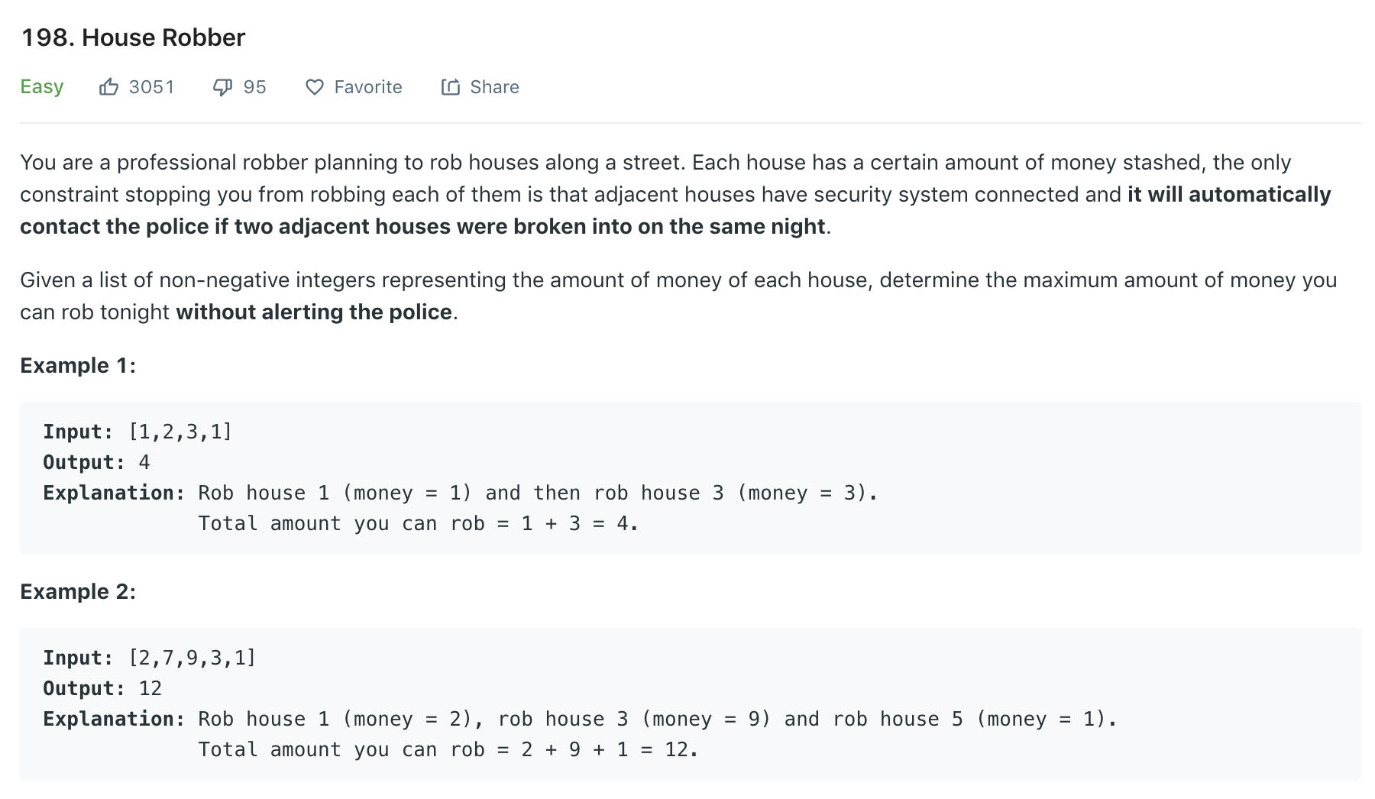

Slide 47
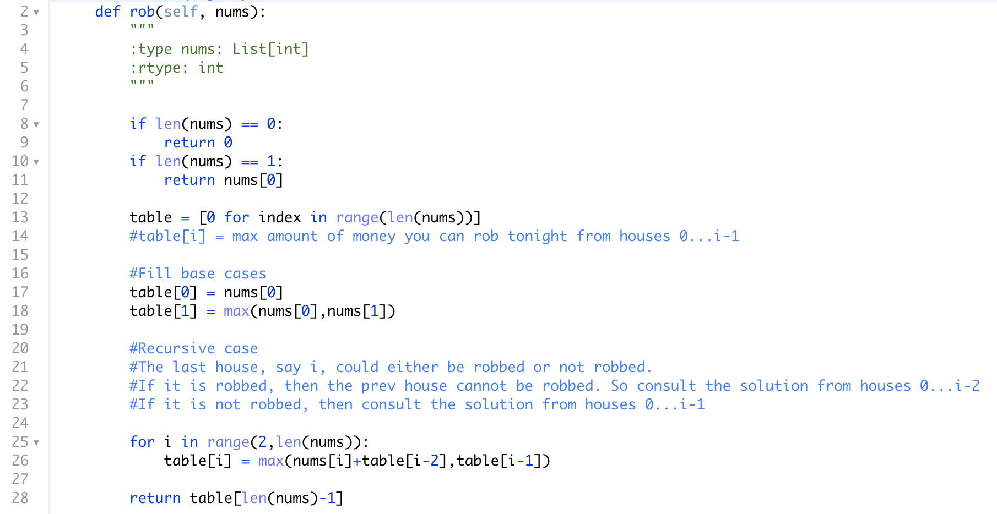

Slide 48
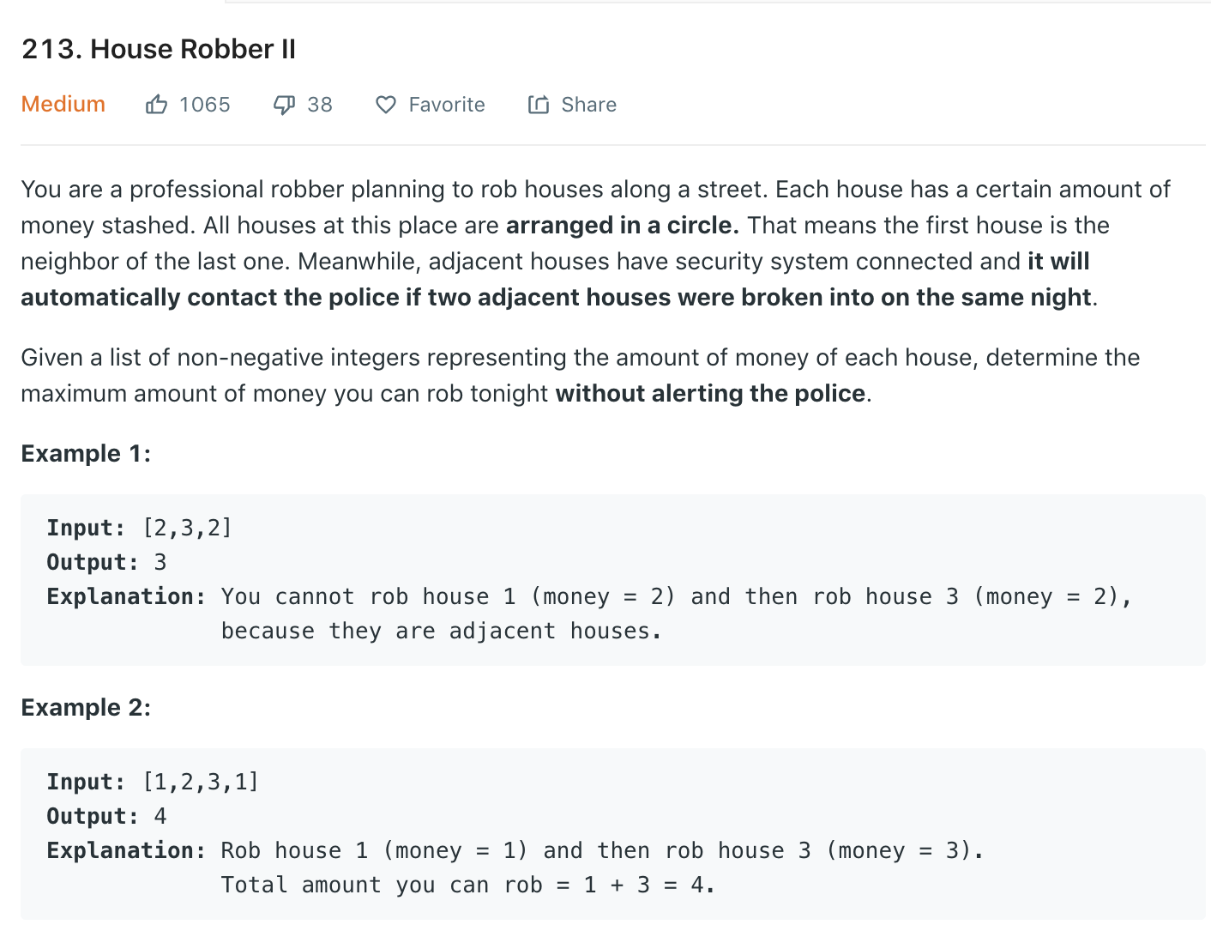

Slide 49
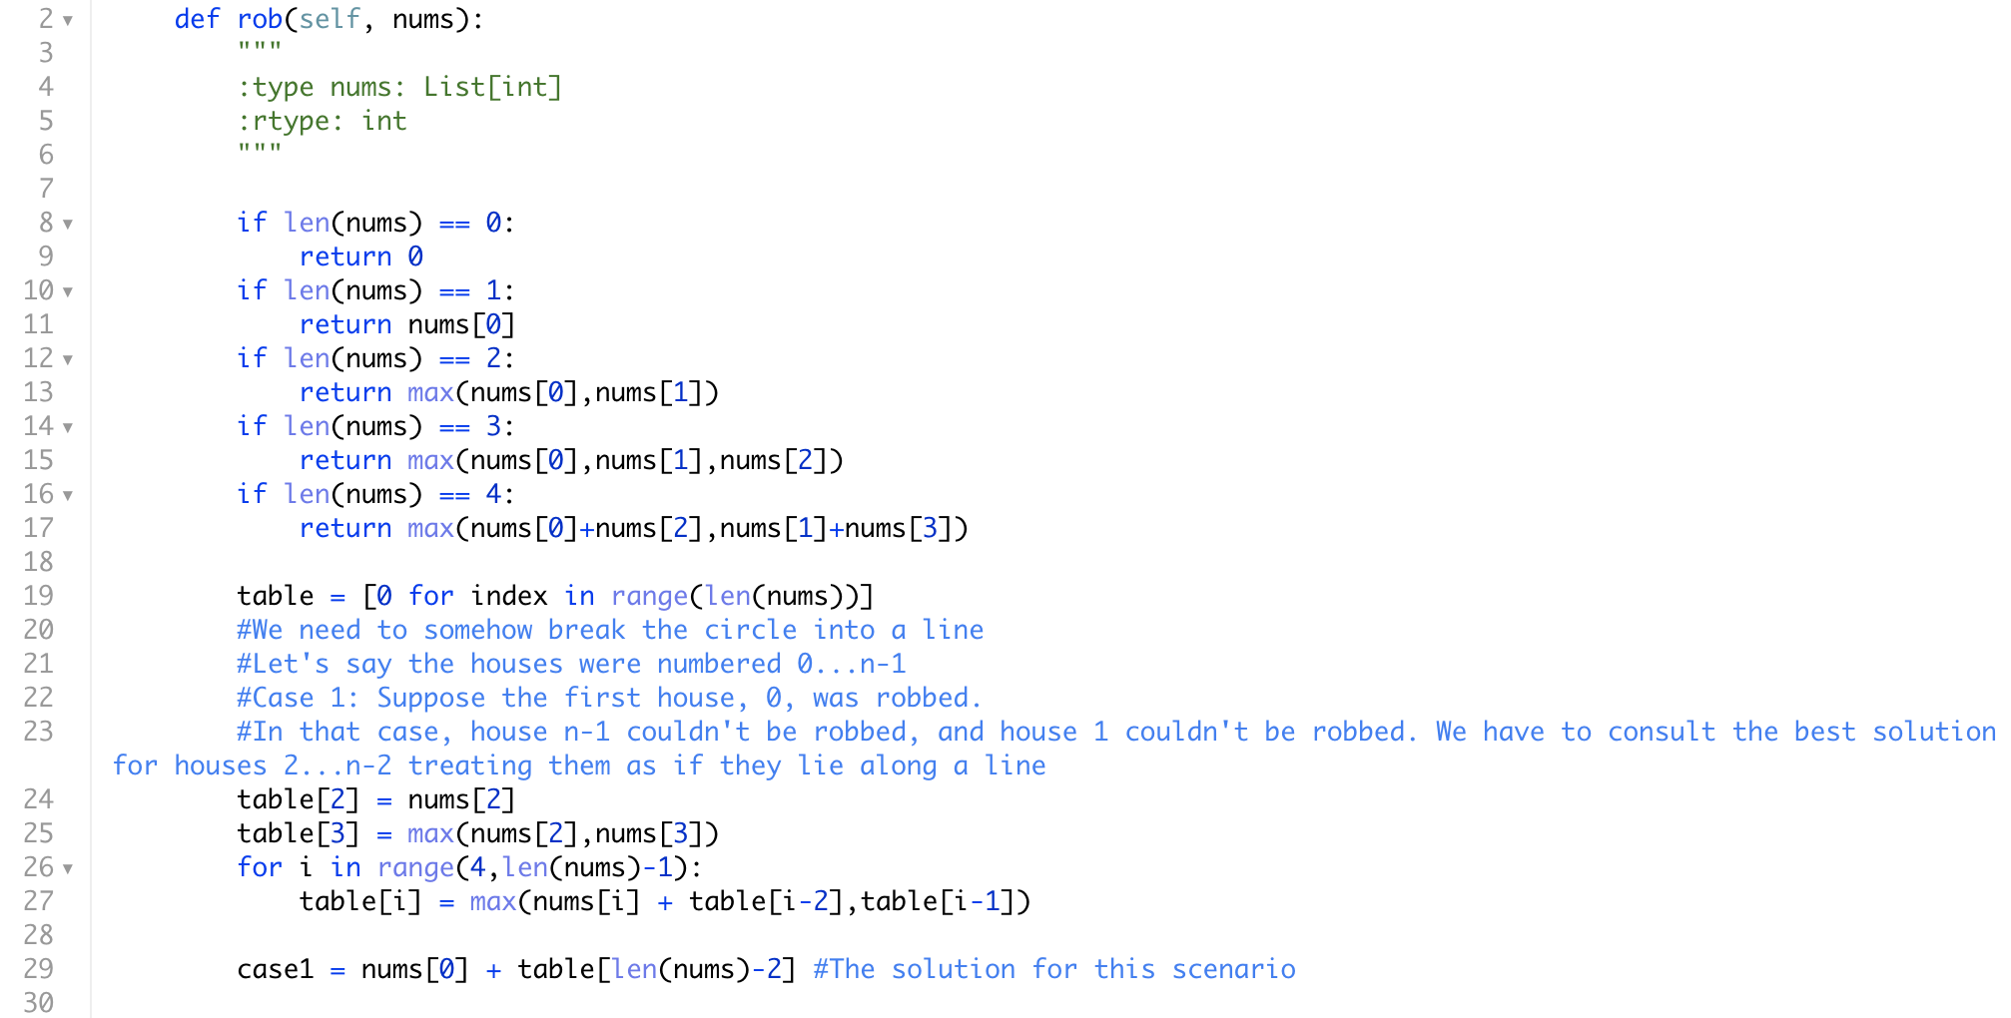

Slide 50
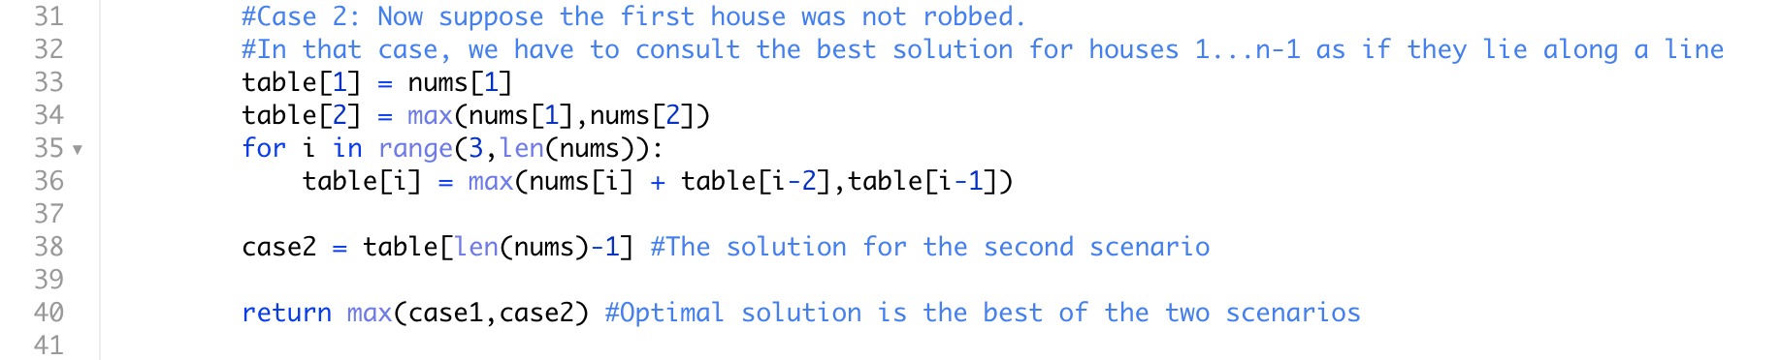

Slide 51
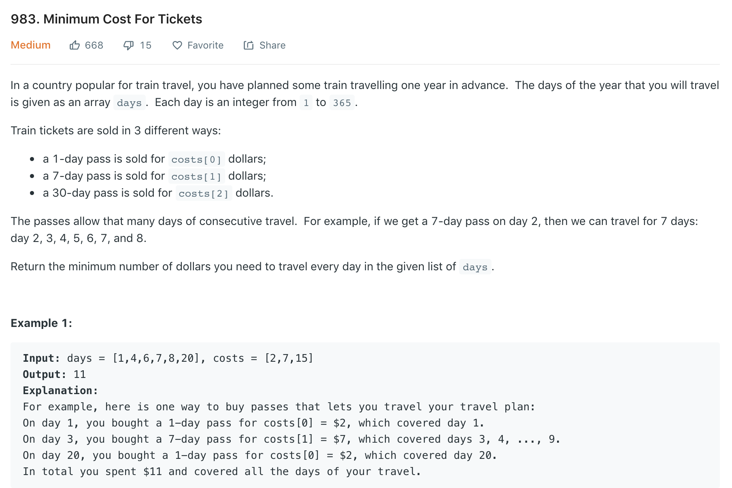

Slide 52
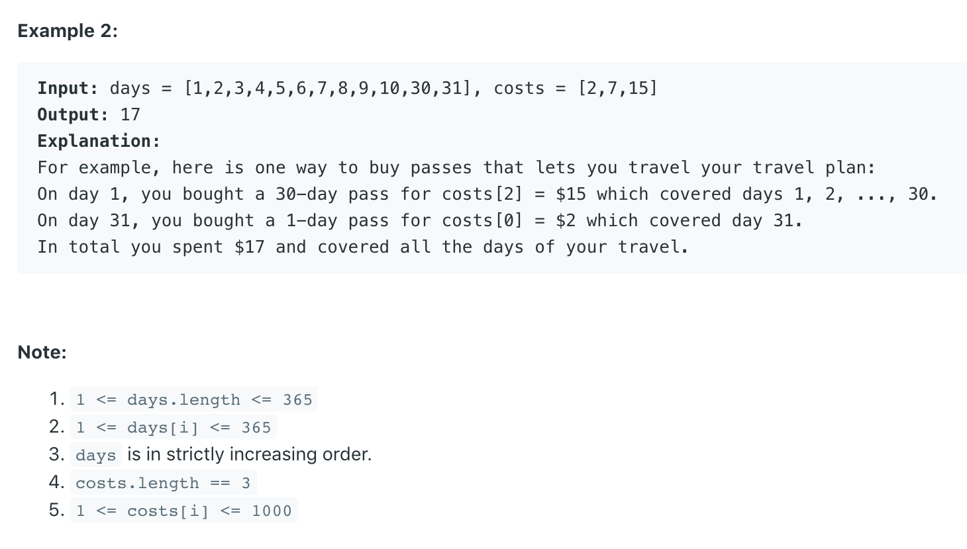

Slide 53
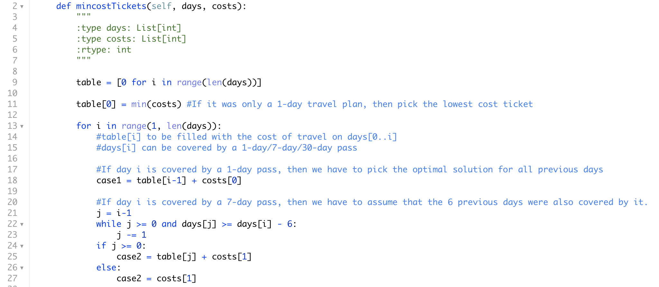

Slide 54
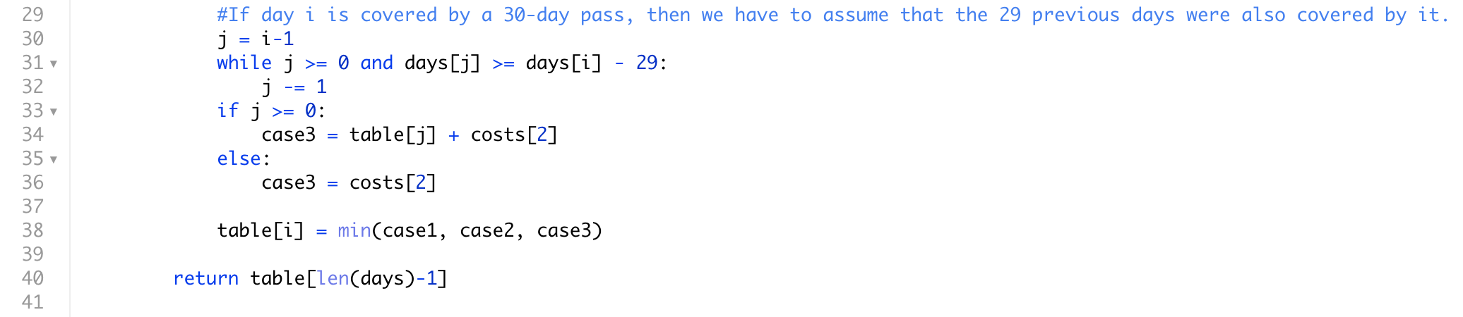

Slide 55
Dynamic Programming
Practice session 3
Omkar Deshpande

Slide 56
Recap
Dynamic Programming (bottom-up tabulation) on two kinds of problems:
(Non-optimization) counting problems
Overlapping subproblems
(Combinatorial Optimization) problems where we found the “best” sequence (one that maximized or minimized some objective function)
Overlapping subproblems
Optimal substructure (required for correctness)
Both these problems would otherwise (without DP) lead to exponential time complexity, since the number of possible sequences to consider are far too many. Caching the results of overlapping subproblems is necessary to curb it.

Slide 57
Non-optimization counting problems
Number of ways to climb n stairs (1D)
Number of ways to go across two rows of a hexagonal grid using n moves to the right. (1D)
Number of ways to tile an n-board using squares, dominoes and trominoes. (1D)
Number of ways to tile a 2 x n board using dominoes and L-shaped trominoes. (1D)
Number of unique paths from the top-left to bottom-right corner of a grid. (2D)
Number of unique paths from the top-left to bottom-right corner of a grid with obstacles at arbitrary locations. (2D)

Slide 58
In every case, exponential time complexity is curbed via DP to get a polynomial time algorithm (or pseudo-polynomial time algorithm).
Also applies to
Computing the nth Fibonacci number (classic 1D DP)
Computing C(n,k) (classic 2D DP)

Slide 59
Combinatorial Optimization problems
The adjective “combinatorial” means that without DP, the combinatorial explosion of possibilities would lead to an exponential time complexity.
After all, we are optimizing permutations and combinations (which are “combinatorial objects”, always exponential in number) by trying to pick the “best”.

Slide 60
Combinatorial optimization problems
Find the min cost path from the top left to bottom right corner of a grid (2D)
Find the min cost path up a flight of n stairs. (1D)
Find the min number of coins needed to make up change for a specified amount of money. (1D)
Find the min post path from the top tip to the bottom row of a triangular grid (2D)
Find the maximum amount of money you can rob from non-adjacent houses in a row (1D)
Find the maximum amount of money you can rob from non-adjacent houses in a circle (1D)
Find the min cost itinerary to travel by train through a country using 1-day/7-day/30-day passes (1D)

Slide 61
f(i,j) = min cost from the top-left corner to cell (i,j) f(i,j) = min[ f(i-1,j), f(i,j-1) ] + cost of cell (i,j)
f(i) = min cost of starting from below and climbing up to stair i f(i) = min over all preceding steps j [ f(j) ] + cost of stair i
f(a) = min number of coins needed to make up amount a f(a) = min [f(a - c_{i})] (for all coin denominations c_{i}) + 1
f(r,k) = min cost path from the top tip of the triangle to row r, entry k f(r,k) = min [ f(r-1,k) + f(r-1,k-1) ] + cost of cell (r,k)

Slide 62
f(i) = maximum amount of money you can rob from houses 0..i f(i) = max [ f(n-2) + cash in house i, f(n-1) ] (for both versions of the house robbery problem)
f(i) = min cost itinerary for day[0]....day[i] (note: the travel days may not be contiguous) f(i) = min [ f(i-1) + cost of ending 1-day pass, f(j) + cost of ending 7-day pass, f(k) + cost of ending 30-day pass] where j,k are the rightmost days not covered by the ending 7-day/30-day pass

Slide 63
Recall: Recursion class
When we enumerated permutations and combinations, we treated them like a sequence of blanks to be filled in : __ __ __ __ __ __ __ __ from left to right.
Here, we are trying to identify the “best” (max/min) sequence of blanks, among an exponential number of possibilities. Combinatorial enumeration can’t usually be done in polynomial time, but combinatorial optimization can be, IF there is optimal substructure and overlapping subproblems. This allows us to use dynamic programming.
Branch-and-Bound doesn’t generally lead to polynomial-time worst case complexity, and Greedy strategy often doesn’t work (and always needs a proof wherever it works)

Slide 64
We imagined an optimal solution laid out in a sequence. We argued that if the last (right-most) element of the optimal solution was examined, there might be a bunch of options for what that rightmost element could be (in general): say the options are case1, case2, case3, …, case k. For each option, look at what the preceding element could be, and formulate the objective function accordingly, for a general preceding element or prefix of the optimal solution. Since the prefixes are also optimal (optimal substructure), we could use the prefix solutions to figure out the overall optimal solution. In this way, we used a decrease-and-conquer strategy to write a recursive formula for the optimal solution (and in general for any prefix of the optimal solution) in terms of optimal solutions for the smaller prefixes (which are the smaller subproblems).

Slide 65
We visualized the different subproblems as vertices in a dependency graph, a DAG. The dependency arrows went from smaller subproblems to larger subproblems.
We saw that the solutions to the subproblems (or prefixes) need to be built up in a convenient topological sort order.
We allocated a table with enough space to hold the solutions to all the subproblems.
We first filled in the base case values at the extreme end of the table, and then for each subsequent entry in the interior of the table, used the recursive formula to calculate and fill in the optimal values for larger subproblems, until the optimal value for the original problem got filled in at the end (or at least can be calculated from the filled table at the end).

Slide 66
We analysed the time and space complexity of the algorithm.
Note: The time complexity for filling in the table = The time complexity for processing the DAG in topological sort order.

Slide 67
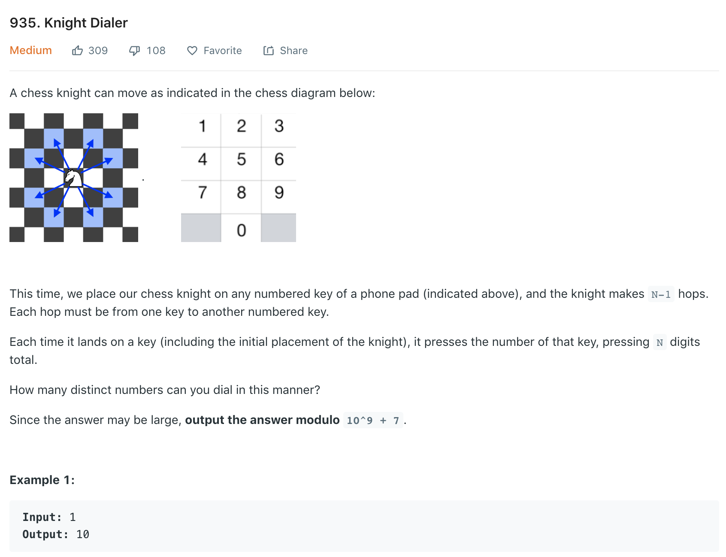

Slide 68
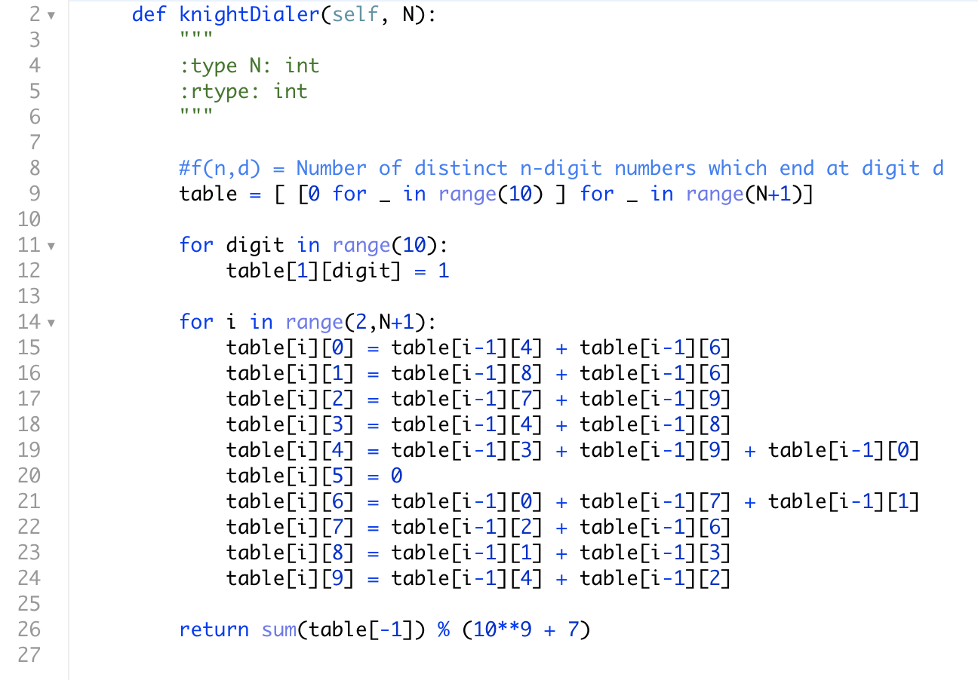

Slide 69
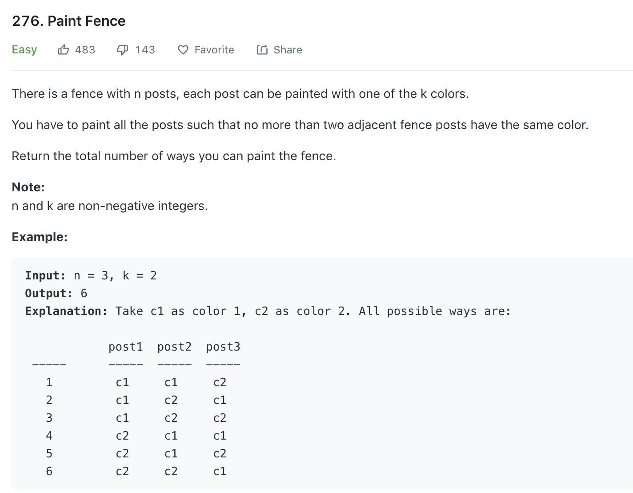

Slide 70
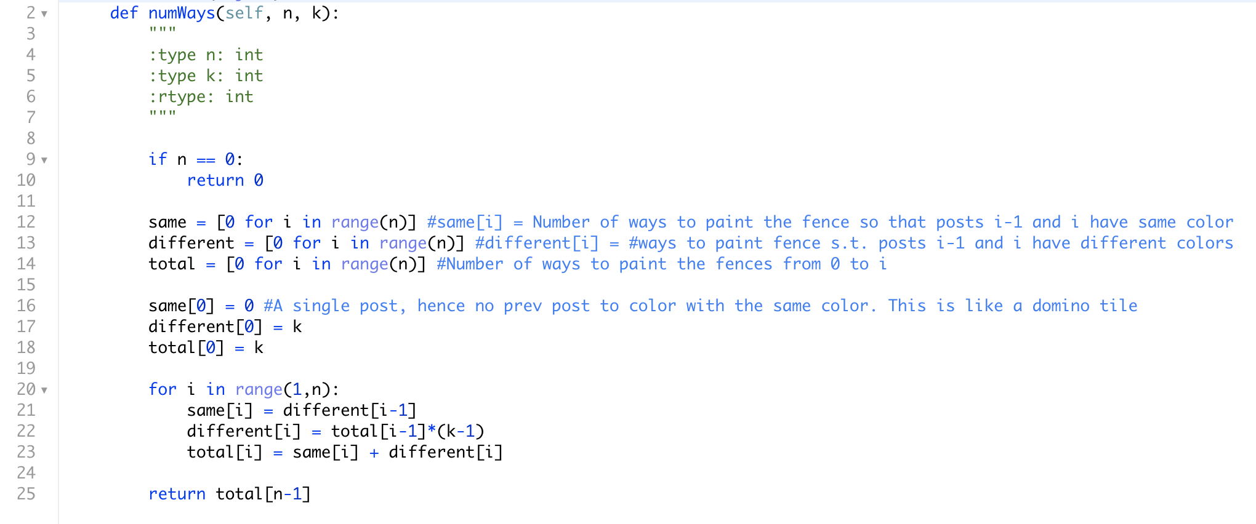

Slide 71
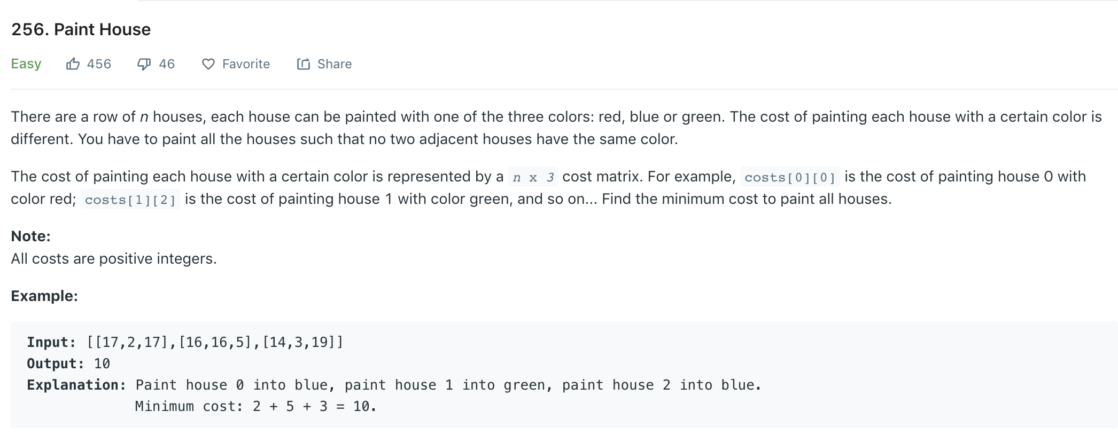

Slide 72
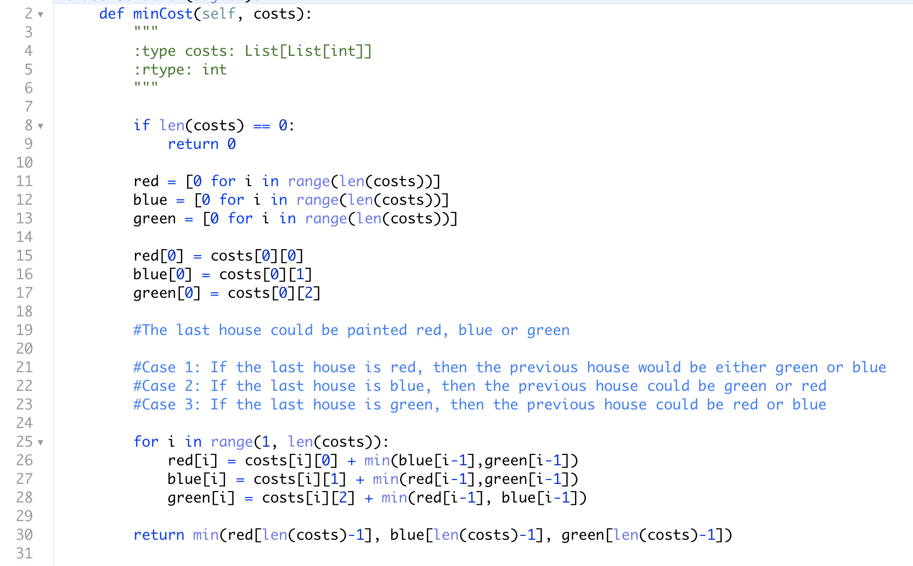

Slide 73
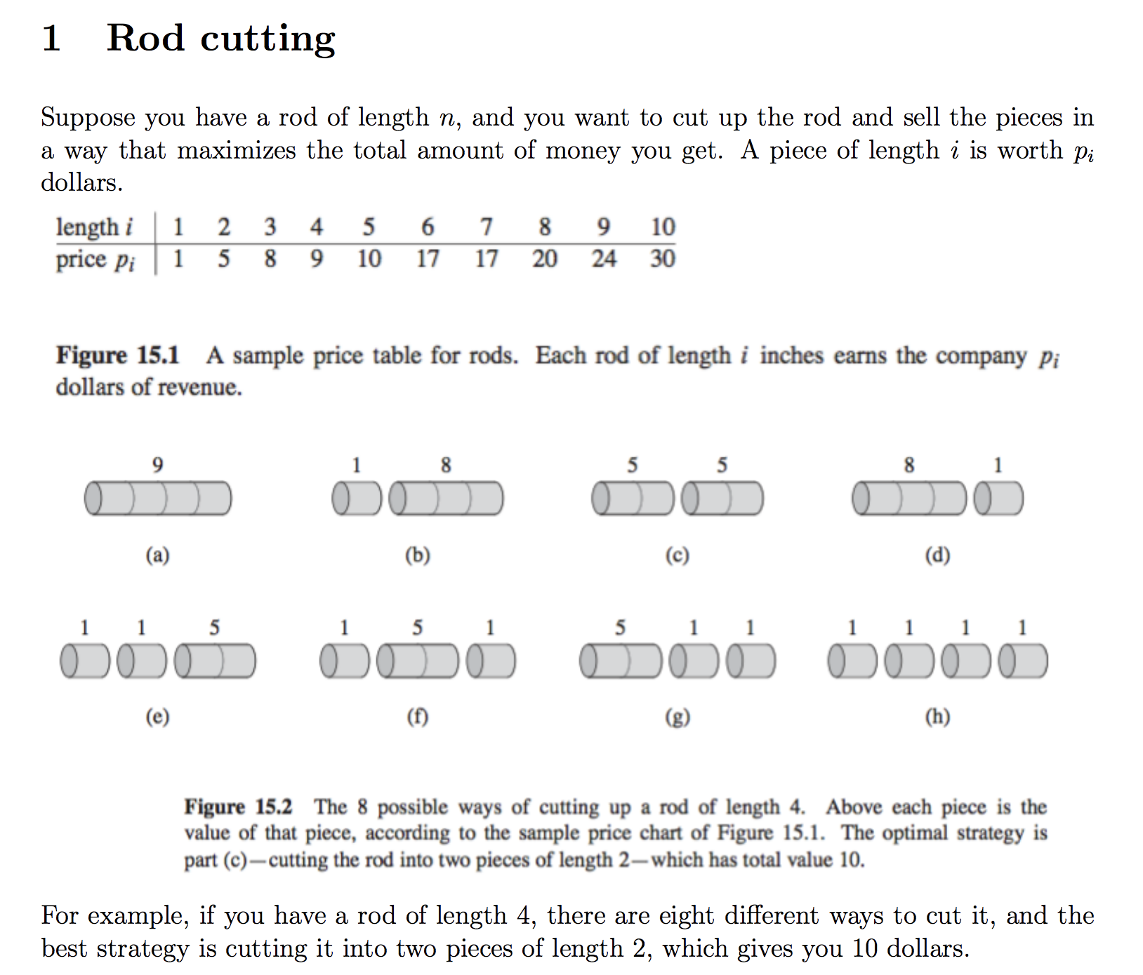

Slide 74
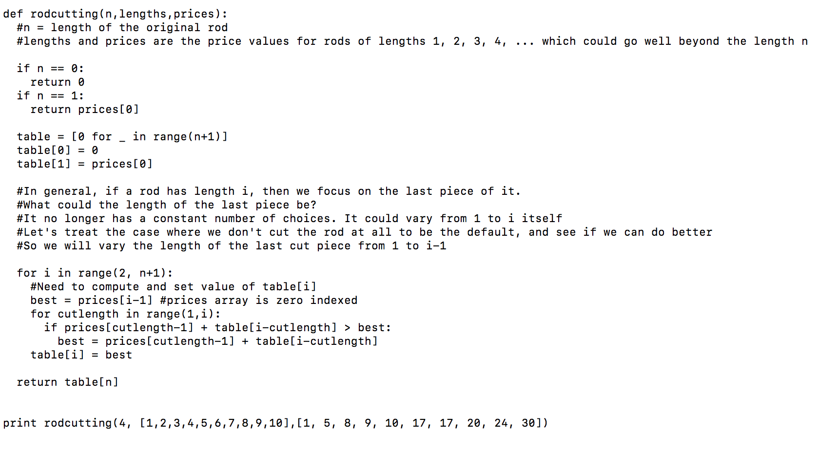

Slide 75
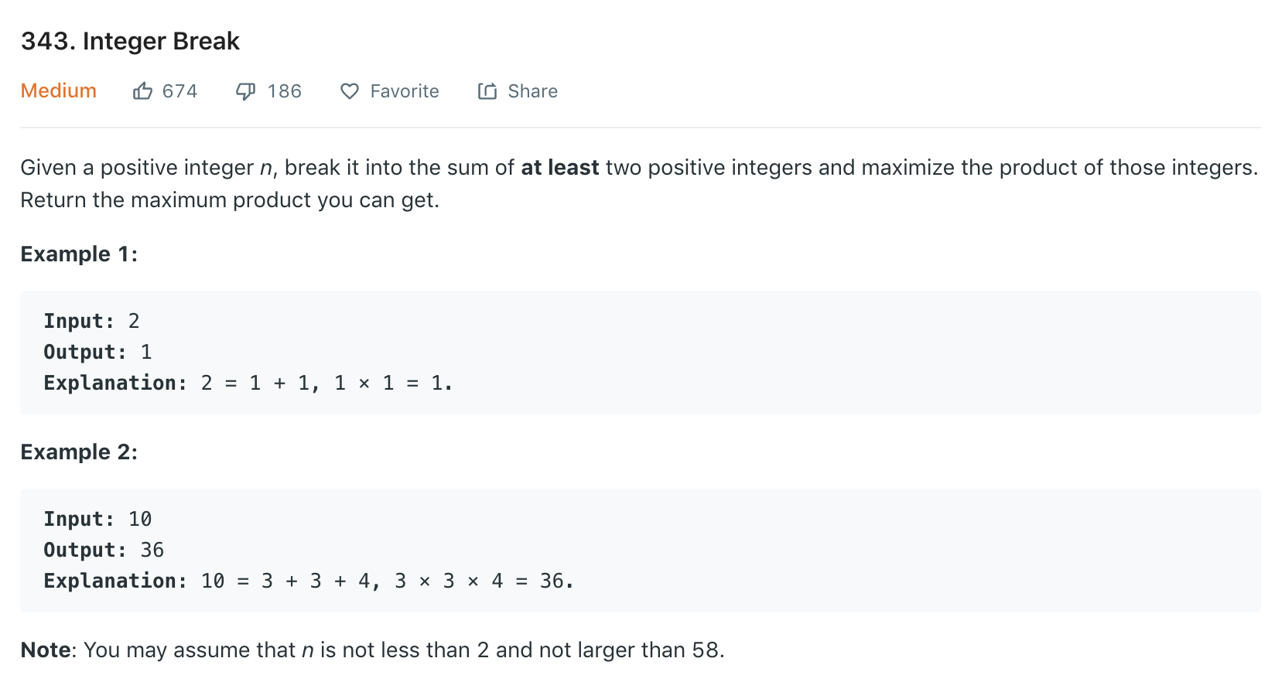

Slide 76
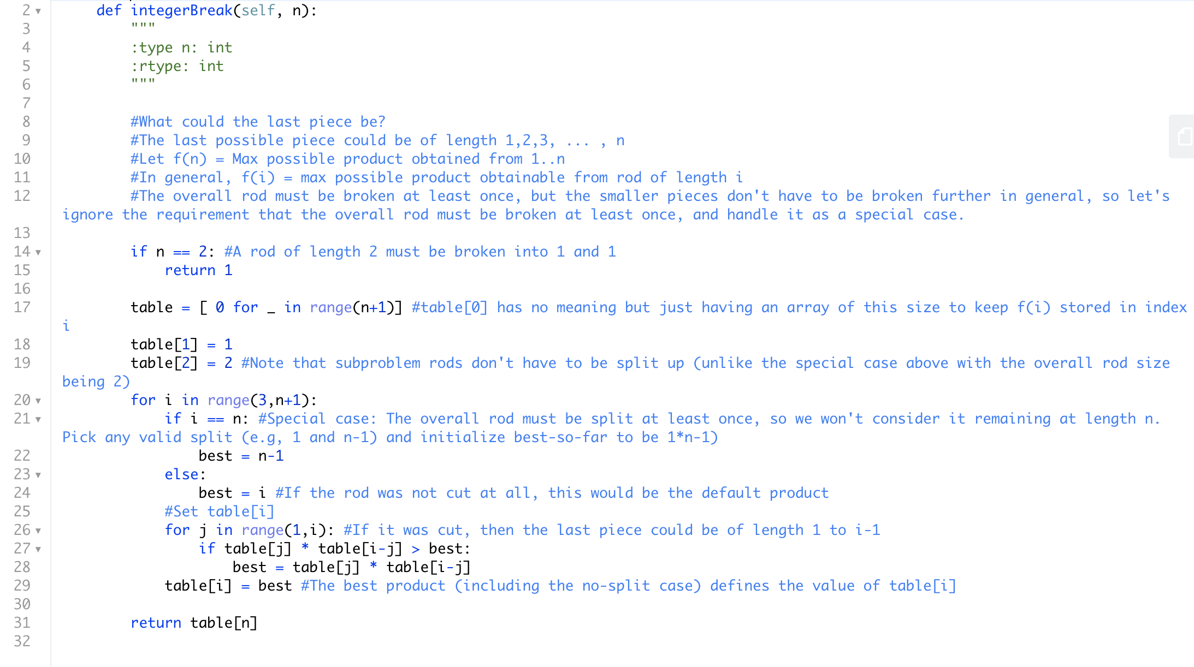

Slide 77
Dynamic Programming
Practice session 4
Omkar Deshpande

Slide 78
Recap
We looked at more combinatorial optimization problems.
The general pattern for solving them was the same:
Think of the optimal solution as something that will be laid out in a sequence. E.g, a sequence of moves of length 1 or 2 in the n stairs problem. A sequence of ~ m+n horizontal or vertical moves in the unique paths / min cost path in a 2D grid problem. A sequence of rob/don’t rob decisions for the n house robbers problem. A sequence of colors for the posts in the Paint Fence problem. A sequence of colors for the houses in the Paint House problem.

Slide 79
2. Focus on the last (rightmost) element of that sequence. Why only the rightmost element? Because you are a lazy manager who just wants to complete the last step of the overall project, depending on your reports to do all the rest of the work.
As a lazy manager, I will only think of - the last move in a unique paths/ min cost path problem or n stairs problem - the decision for the last house in the house robbers problem - the last digit in the knight dialers problem - the last house or fence post to be colored

Slide 80
3. Think about the different choices/options for what the rightmost element could be, and for each of those options, what the preceding subproblem (neighbor) could be, and what information from those preceding subproblem neighbors would be required for you to solve your problem.
The last move could be from the previous step or the previous-to-previous step. Or I could reach the bottom right cell from the neighbor on the top or the neighbor to my left.
The last decision could be to rob/not rob that last house. That depends on whether the previous house was robbed/not robbed.
The last day could be covered by a 1-day/7-day/30-day pass. That depends on how the previous n-1 days, n-7 days, or n-30 days were covered.
The last piece of the rod could be 1, 2, …. n units long. That depends on how the previous section of the rod of length n-1 / n-2 / .. could be cut to maximize profit.
The last digit could be 0…. 9 in the phone dialpad. That depends on whether the previous digit was a 4 or 6, a 6 or 8, and so on.
The last color could be any of the k colors (if the previous two colors were different) or k-1 colors (if the previous two colors were the same).

Slide 81
4. Remember that each preceding subproblem is going to be solved by one of your immediate reports. You will get to work AFTER they have done their work.
5. Because they are equally lazy like you, they too will be working on only the rightmost bit of their solution, and relying on their subordinates for the solution to the remaining prefix of the problem.
6. In this way, down the corporate hierarchy, the workers will be working on smaller and smaller prefixes of the original problem.
7. The leaf-level workers will first solve the base-case versions of the subproblems.

Slide 82
8. In the recursion class, every worker had exactly one manager they were reporting to. There was a lot of redundant work being done in the corporate hierarchy, as several subtrees were working on solving the same set of subproblems. (Overlapping subproblems) The number of workers employed was exponential.
9. That redundancy is going to be eliminated by DP by “laying off” large subtrees of workers. In the reorganized corporate hierarchy, every worker is working on a unique subproblem. Since the number of unique subproblems will be polynomial, the number of workers will also be polynomial (we have a much smaller company now!).

Slide 83
10. Instead of a huge corporate tree, we now have a much-reduced corporate DAG. Think of every subproblem in the DAG as being solved by an individual worker.
11. Each worker can now have multiple managers they report to. Each manager (as before) continues to have multiple reports (but they may not be the sole manager for any of those reports).
12. Every worker in the hierarchy is using the solutions from his/her reports to build the solution for a slightly larger prefix, and handing it above to all the managers he/she reports to.

Slide 84
13. You are the root manager at the top, and you will combine the solutions from your immediate reports to build the solution for the overall problem.
14. In the top-down approach we had for combinatorial enumeration, you first filled in the leftmost blank, and handed the remaining subproblem (a suffix of the original problem) down to your reports. They successively filled in more and more of the blanks, until the leaf-level nodes would complete individual solutions (and there were an exponential number of them).
15. DP is bottom-up. Each leaf node fills in the leftmost blank, and hands the solution up to the managers above, who in turn fill in the leftmost blank for their slightly larger subproblem, and this process goes purely “bottom-up” until at the top-level, you fill in the last remaining blank (the rightmost blank) and generate the complete solution.

Slide 85
16. Whether top-down or bottom-up, the optimal solution sequence (or the counts of the number of sequences) is being constructed from left to right. So the prefix (partial solution) grows into the full solution at the end.
17. (Coming back to the DP approach) - Each worker is counting or optimizing a slightly larger prefix than the workers below them (or equivalently, workers before them in topological sort order). - The solutions to the earlier prefixes are already available when a worker gets to work on his/her task. Those earlier solutions are cached and just need to be “looked up” from some kind of table. - After computing the solution to his/her problem, an individual worker will then write that solution value into another cell of the same table. There is no recursive call going back to a caller. The next worker in top sort order will automatically get to work on the next subproblem.

Slide 86
18. Coming up with the recurrence formula:
I am given an overall task on a problem of size n. Since I will worry only about the rightmost piece of the optimal sequence (or the rightmost blank for a counting problem), I will think about what information I need from my reports to construct the solution for my problem. And that is what every worker will do: think “I am given an overall task of size i. Since I will worry only about the rightmost piece of the optimal sequence (or the rightmost blank for a counting problem), I will think about what information I need from my reports to construct the solution for my problem.”

Slide 87
Whatever information I need from my reports, it will have the same form as the information that a general worker will need from their reports, and what they will need to pass to their own managers (who will expect the same information from them). The difference between the workers is only in the size of the problem (prefix) that each worker is working on.
The structure of that information will determine whether we need additional parameters for the function apart from the problem size (i), and whether we need multiple functions to be computed.
Since that information is going to be stored in the table/cache, the dimensions/size of the table (and even the number of tables) will depend on the form of that information.

Slide 88
E.g, if (for my task) I just need to know how many paths there were up to my two previous neighbors, that means each worker needs to calculate the number of paths leading up to them, and pass on that information to their manager.
If I need to know not just the total number of ways to color the previous n-1 fence posts, but also how many of them had the last two fences of the same color (or different color).... that means every worker needs to calculate the number of ways to color the (prefix) fence posts upto post i, such that the last fences were of the same color (or different color).
If I need to know not just the best way to color n-1 houses, but the best way to color them so that the rightmost house among them is green (or red, or blue), every worker in the hierarchy working on every prefix must compute the same information and pass it on to the immediate manager.

Slide 89


Slide 90


Slide 91


Slide 92


Slide 93


Slide 94


Slide 95


Slide 96


Slide 97


Slide 98


Slide 99


Slide 100


Slide 101
Dynamic Programming
Practice session 5
Omkar Deshpande

Slide 102
Recap
We looked at more combinatorial optimization problems.
The general pattern for solving them was the same:
Think of the optimal solution as something that will be laid out in a sequence. E.g, a sequence of moves of length 1 or 2 in the n stairs problem. A sequence of ~ m+n horizontal or vertical moves in the unique paths / min cost path in a 2D grid problem. A sequence of rob/don’t rob decisions for the n house robbers problem. A sequence of colors for the posts in the Paint Fence problem. A sequence of colors for the houses in the Paint House problem.

Slide 103
2. Focus on the last (rightmost) element of that sequence. Why only the rightmost element? Because you are a lazy manager who just wants to complete the last step of the overall project, depending on your reports to do all the rest of the work.
As a lazy manager, I will only think of - the last move in a unique paths/ min cost path problem or n stairs problem - the decision for the last house in the house robbers problem - the last digit in the knight dialers problem - the last house or fence post to be colored

Slide 104
3. Think about the different choices/options for what the rightmost element could be, and for each of those options, what the preceding subproblem (neighbor) could be, and what information from those preceding subproblem neighbors would be required for you to solve your problem.
The last move could be from the previous step or the previous-to-previous step. Or I could reach the bottom right cell from the neighbor on the top or the neighbor to my left.
The last decision could be to rob/not rob that last house. That depends on whether the previous house was robbed/not robbed.
The last day could be covered by a 1-day/7-day/30-day pass. That depends on how the previous n-1 days, n-7 days, or n-30 days were covered.
The last piece of the rod could be 1, 2, …. n units long. That depends on how the previous section of the rod of length n-1 / n-2 / .. could be cut to maximize profit.
The last digit could be 0…. 9 in the phone dialpad. That depends on whether the previous digit was a 4 or 6, a 6 or 8, and so on.
The last color could be any of the k colors (if the previous two colors were different) or k-1 colors (if the previous two colors were the same).

Slide 105
4. Remember that each preceding subproblem is going to be solved by one of your immediate reports. You will get to work AFTER they have done their work.
5. Because they are equally lazy like you, they too will be working on only the rightmost bit of their solution, and relying on their subordinates for the solution to the remaining prefix of the problem.
6. In this way, down the corporate hierarchy, the workers will be working on smaller and smaller prefixes of the original problem.
7. The leaf-level workers will first solve the base-case versions of the subproblems.

Slide 106
8. In the recursion class, every worker had exactly one manager they were reporting to. There was a lot of redundant work being done in the corporate hierarchy, as several subtrees were working on solving the same set of subproblems. (Overlapping subproblems) The number of workers employed was exponential.
9. That redundancy is going to be eliminated by DP by “laying off” large subtrees of workers. In the reorganized corporate hierarchy, every worker is working on a unique subproblem. Since the number of unique subproblems will be polynomial, the number of workers will also be polynomial (we have a much smaller company now!).

Slide 107
10. Instead of a huge corporate tree, we now have a much-reduced corporate DAG. Think of every subproblem in the DAG as being solved by an individual worker.
11. Each worker can now have multiple managers they report to. Each manager (as before) continues to have multiple reports (but they may not be the sole manager for any of those reports).
12. Every worker in the hierarchy is using the solutions from his/her reports to build the solution for a slightly larger prefix, and handing it above to all the managers he/she reports to.

Slide 108
13. You are the root manager at the top, and you will combine the solutions from your immediate reports to build the solution for the overall problem.
14. In the top-down approach we had for combinatorial enumeration, you first filled in the leftmost blank, and handed the remaining subproblem (a suffix of the original problem) down to your reports. They successively filled in more and more of the blanks, until the leaf-level nodes would complete individual solutions (and there were an exponential number of them).
15. DP is bottom-up. Each leaf node fills in the leftmost blank, and hands the solution up to the managers above, who in turn fill in the leftmost blank for their slightly larger subproblem, and this process goes purely “bottom-up” until at the top-level, you fill in the last remaining blank (the rightmost blank) and generate the complete solution.

Slide 109
16. Whether top-down or bottom-up, the optimal solution sequence (or the counts of the number of sequences) is being constructed from left to right. So the prefix (partial solution) grows into the full solution at the end.
17. (Coming back to the DP approach) - Each worker is counting or optimizing a slightly larger prefix than the workers below them (or equivalently, workers before them in topological sort order). - The solutions to the earlier prefixes are already available when a worker gets to work on his/her task. Those earlier solutions are cached and just need to be “looked up” from some kind of table. - After computing the solution to his/her problem, an individual worker will then write that solution value into another cell of the same table. There is no recursive call going back to a caller. The next worker in top sort order will automatically get to work on the next subproblem.

Slide 110
18. Coming up with the recurrence formula:
I am given an overall task on a problem of size n. Since I will worry only about the rightmost piece of the optimal sequence (or the rightmost blank for a counting problem), I will think about what information I need from my reports to construct the solution for my problem. And that is what every worker will do: think “I am given an overall task of size i. Since I will worry only about the rightmost piece of the optimal sequence (or the rightmost blank for a counting problem), I will think about what information I need from my reports to construct the solution for my problem.”

Slide 111
Whatever information I need from my reports, it will have the same form as the information that a general worker will need from their reports, and what they will need to pass to their own managers (who will expect the same information from them). The difference between the workers is only in the size of the problem (prefix) that each worker is working on.
The structure of that information will determine whether we need additional parameters for the function apart from the problem size (i), and whether we need multiple functions to be computed.
Since that information is going to be stored in the table/cache, the dimensions/size of the table (and even the number of tables) will depend on the form of that information.

Slide 112
Subproblem patterns
In all problems we have seen so far, we have been trying to count or optimize permutations/combinations that can be visualised as sequences.
If the overall problem is the sequence x₁, x₂, x₃, …, x_{n},
the subproblems are prefixes of the form x₁, x₂, … , x_{i}

Slide 113


Slide 114


Slide 115
Subproblem patterns
Even when the input was in the form of two strings
x₁, x₂, x₃, …, x_{m} and y₁, y₂, y₃, …, y_{n}
we visualised an alignment of the sequences and tried to optimize the alignment, treating it as a single sequence.
The subproblems were prefixes of the form x₁, x₂, …, x_{i} and y₁, y₂, …, y_{j}

Slide 116


Slide 117


Slide 118


Slide 119


Slide 120


Slide 121


Slide 122


Slide 123

Memoization

Slide 124

Order of these two could affect running time!

Slide 125
Minimization problem: Compute the shortest path from s to d in the dependency DAG.
Maximization problem: Compute the longest path from s to d in the dependency DAG
Counting problem: Compute the number of paths from s to d in the dependency DAG.
Decision problem: Figure out if there exists a path from s to d in the dependency DAG.

Slide 126
Knapsack problem
During a robbery, a burglar finds much more loot than he had expected and has to decide what to take. His bag (“knapsack”) will hold a total weight of at most W pounds. There are n items to pick from, of weight w1, w2, … wn and dollar value v1, v2, ... , vn. What is the most valuable combination of items he can fit into his bag?
E.g, W = 10
Item1: weight = 6, value = 30$
Item2: weight = 3, value = 14$
Item3: weight = 4, value = 16$
Item4: weight = 2, value = 9$
Notes:
46 from art gallery, 48 from factory

Slide 127
Three versions of Knapsack
Only one copy of each item available. (0-1 Knapsack)
Unlimited quantities of each item available. (Unbounded Knapsack)
One copy of each item, but the robber can steal a fraction of an item also. (Fractional Knapsack or Continuous Knapsack)

Slide 128
Dynamic Programming
Live Class
Omkar Deshpande

Slide 129
Recap of foundation videos
Dynamic Programming is doing recursion without repetition.
Two variants:
Memoization (top-down)
Tabulation (bottom-up)
We generally (though not always) prefer bottom-up tabulation over top-down memoization.

Slide 130
Classic DP problems
Computing the nth Fibonacci number (classic 1D DP)
Computing C(n,k) (classic 2D DP)

Slide 131
(Non-optimization) Counting problems
Number of ways to climb n stairs (1D)
Number of unique paths from the top-left to bottom-right corner of a grid. (2D)
Overlapping subproblems

Slide 132
Combinatorial Optimization problems
The adjective “combinatorial” means that without DP, the combinatorial explosion of possibilities would lead to an exponential time complexity.
After all, we are optimizing permutations and combinations (which are “combinatorial objects”, always exponential in number) by trying to pick the “best”.
Min cost way to climb n stairs (1D)
Maximum path sum in a 2D grid (2D)
Minimum number of coins making up change (1D)
Overlapping subproblems + Optimal substructure

Slide 133
Recap
We looked at counting and optimization problems.
The general pattern for solving them was the same:
Think of the optimal solution as something that will be laid out in a sequence. E.g, a sequence of moves of length 1 or 2 in the n stairs problem. A sequence of ~ m+n horizontal or vertical moves in the unique paths / min cost path in a 2D grid problem.

Slide 134
Decrease-and-conquer
2. Focus on the last (rightmost) element of that sequence. Why only the rightmost element? Because you are a lazy manager who just wants to complete the last step of the overall project, depending on your reports to do all the rest of the work.
As a lazy manager, I will only think of - the last move in a unique paths/ min cost path problem or n stairs problem - the last coin in the coin change problem

Slide 135
3. Think about the different choices/options for what the rightmost element could be, and for each of those options, what the preceding subproblem (neighbor) could be, and what information from those preceding subproblem neighbors would be required for you to solve your problem.
The last move could be from the previous step or the previous-to-previous step. Or I could reach the bottom right cell from the neighbor on the top or the neighbor to my left.

Slide 136
4. Remember that each preceding subproblem is going to be solved by one of your immediate reports. You will get to work AFTER they have done their work.
5. Because they are equally lazy like you, they too will be working on only the rightmost bit of their solution, and relying on their subordinates for the solution to the remaining prefix of the problem.
6. In this way, down the corporate hierarchy, the workers will be working on smaller and smaller prefixes of the original problem.
7. The leaf-level workers will first solve the base-case versions of the subproblems.

Slide 137
8. In the recursion class, every worker had exactly one manager they were reporting to. There was a lot of redundant work being done in the corporate hierarchy, as several subtrees were working on solving the same set of subproblems. (Overlapping subproblems) The number of workers employed was exponential.
9. That redundancy is going to be eliminated by DP by “laying off” large subtrees of workers. In the reorganized corporate hierarchy, every worker is working on a unique subproblem. Since the number of unique subproblems will be polynomial, the number of workers will also be polynomial (we have a much smaller company now!).

Slide 138
10. Instead of a huge corporate tree, we now have a much-reduced corporate DAG. Think of every subproblem in the DAG as being solved by an individual worker.
11. Each worker can now have multiple managers they report to. Each manager (as before) continues to have multiple reports (but they may not be the sole manager for any of those reports).
12. Every worker in the hierarchy is using the solutions from his/her reports to build the solution for a slightly larger prefix, and handing it above to all the managers he/she reports to.

Slide 139
13. You are the root manager at the top, and you will combine the solutions from your immediate reports to build the solution for the overall problem.
14. In the top-down approach we had for combinatorial enumeration, you first filled in the leftmost blank, and handed the remaining subproblem (a suffix of the original problem) down to your reports. They successively filled in more and more of the blanks, until the leaf-level nodes would complete individual solutions (and there were an exponential number of them).
15. DP is bottom-up. Each leaf node fills in the leftmost blank, and hands the solution up to the managers above, who in turn fill in the leftmost blank for their slightly larger subproblem, and this process goes purely “bottom-up” until at the top-level, you fill in the last remaining blank (the rightmost blank) and generate the complete solution.

Slide 140
16. Whether top-down or bottom-up, the optimal solution sequence (or the counts of the number of sequences) is being constructed from left to right. So the prefix (partial solution) grows into the full solution at the end.
17. (Coming back to the DP approach) - Each worker is counting or optimizing a slightly larger prefix than the workers below them (or equivalently, workers before them in topological sort order). - The solutions to the earlier prefixes are already available when a worker gets to work on his/her task. Those earlier solutions are cached and just need to be “looked up” from some kind of table. - After computing the solution to his/her problem, an individual worker will then write that solution value into another cell of the same table. There is no recursive call going back to a caller. The next worker in top sort order will automatically get to work on the next subproblem.

Slide 141
18. Coming up with the recurrence formula:
I am given an overall task on a problem of size n. Since I will worry only about the rightmost piece of the optimal sequence (or the rightmost blank for a counting problem), I will think about what information I need from my reports to construct the solution for my problem. And that is what every worker will do: think “I am given an overall task of size i. Since I will worry only about the rightmost piece of the optimal sequence (or the rightmost blank for a counting problem), I will think about what information I need from my reports to construct the solution for my problem.”

Slide 142
Whatever information I need from my reports, it will have the same form as the information that a general worker will need from their reports, and what they will need to pass to their own managers (who will expect the same information from them). The difference between the workers is only in the size of the problem (prefix) that each worker is working on.
The structure of that information will determine whether we need additional parameters for the function apart from the problem size (i), and whether we need multiple functions to be computed.
Since that information is going to be stored in the table/cache, the dimensions/size of the table (and even the number of tables) will depend on the form of that information.

Slide 143


Slide 144

BOTHEARTHANDSATURNSPIN
Can this be segmented into English words at all?
Decision Problem: Yes/No answer

Slide 145


Slide 146
Counting version
Count all different possible word-break arrangements for the string s. This integer could be large so output it modulo 10^9 + 7.

Slide 147


Slide 148
Optimization version
Find the best possible word break arrangement for the string s. Assume that each word is associated with a score in the dictionary, indicating how common it is.

Slide 152


Slide 153


Slide 154


Slide 155


Slide 156


Slide 157


